Slide 1

De Betekeniseconomie
Het nieuwe normaal
Kees Klomp, Professor of applied science

Slide 2
Wat is economie?

Slide 3
A social science, which revolves around the relationships between individuals and societies
Household management
Organizational principles
Allocation rules
The study of the efficiency
Understanding/defining human behavior based upon scarcity, supply and demand, costs and benefits, and incentives

Slide 4
Wat zijn Betekeniseconomie kenmerken?

Slide 5

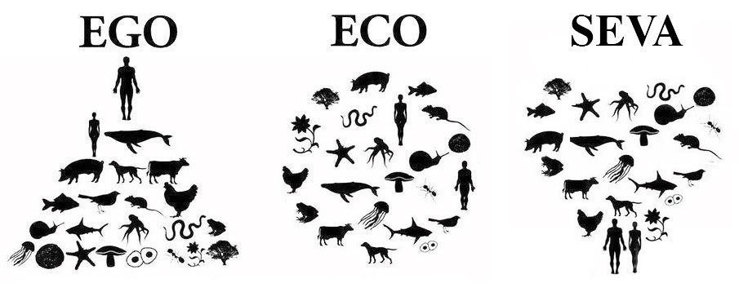
SEVA (Serve)

Slide 6
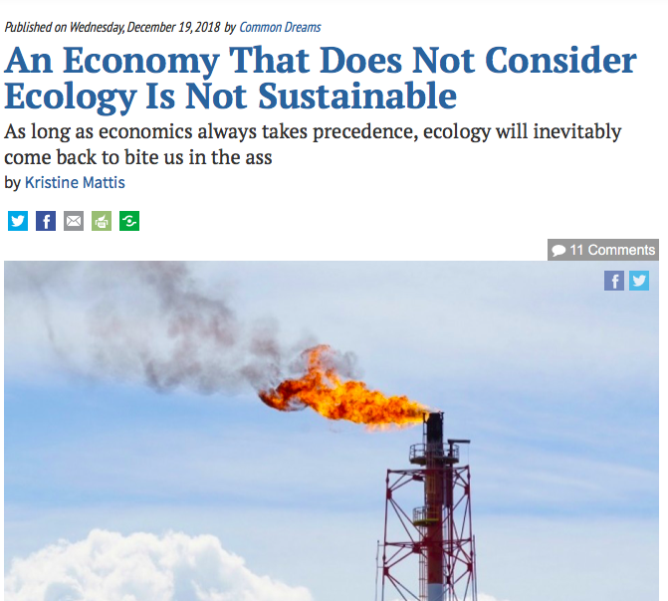
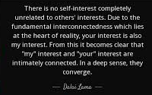
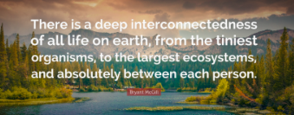
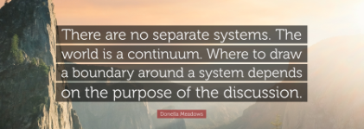

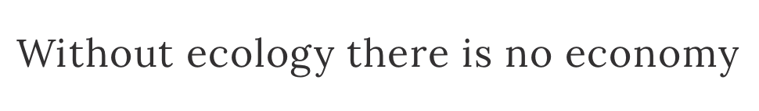
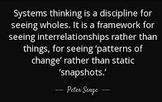
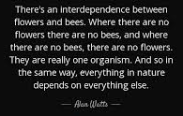

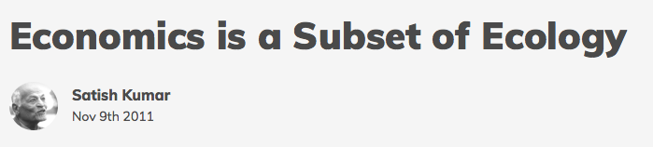
System Thinking

Slide 7
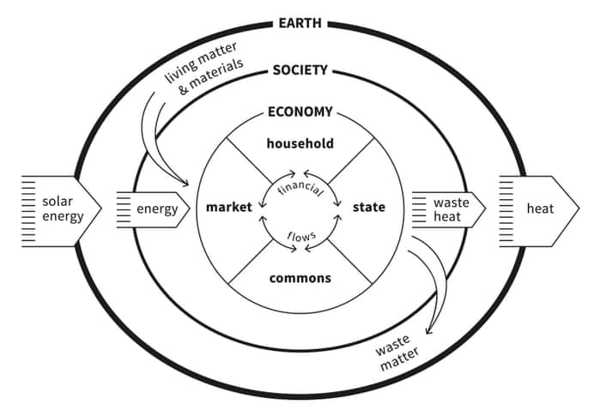
Embedded

Slide 8
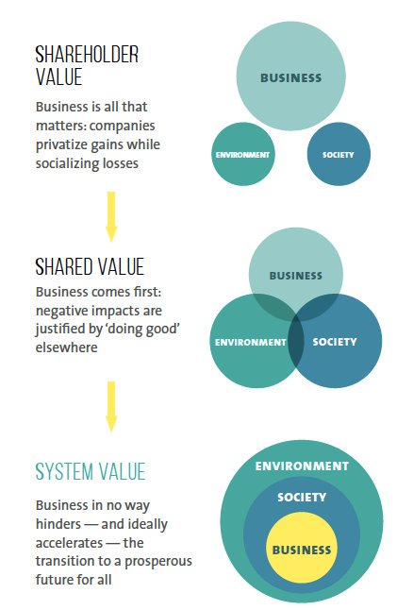
System Value

Slide 9
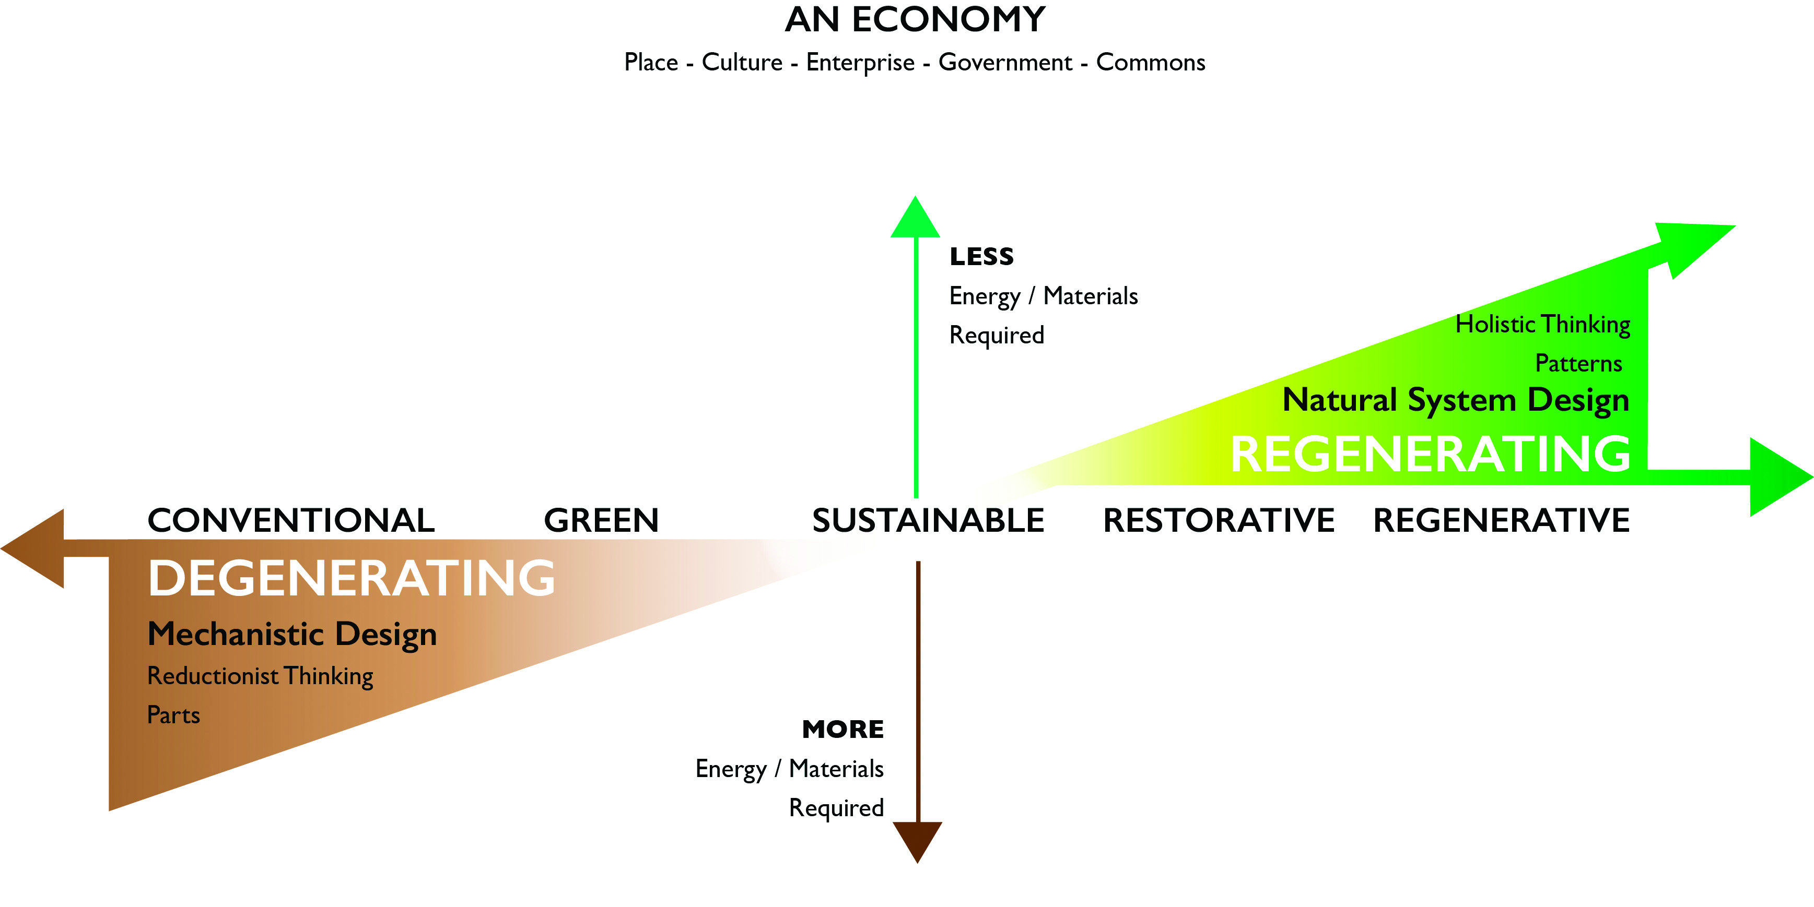
Regenerative

Slide 10



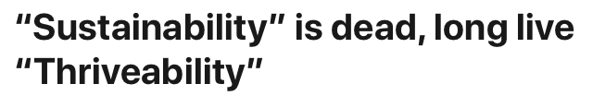

Thriveability

Slide 11
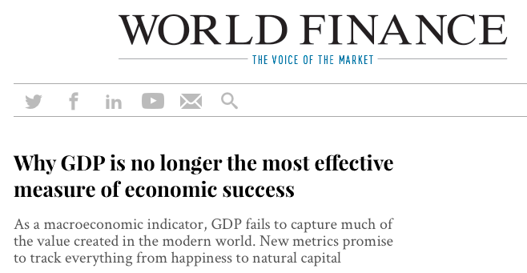
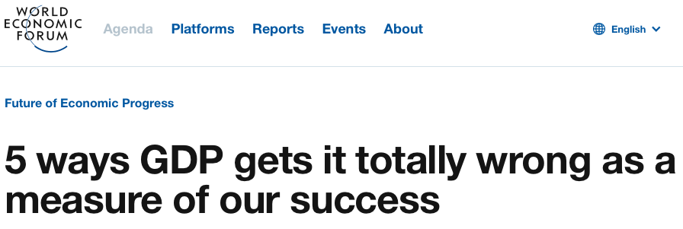
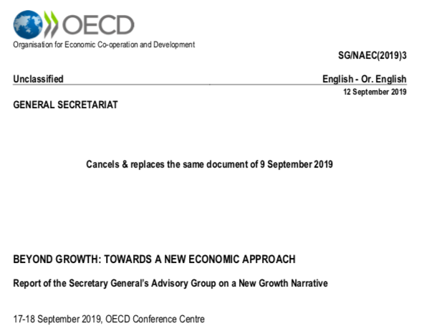

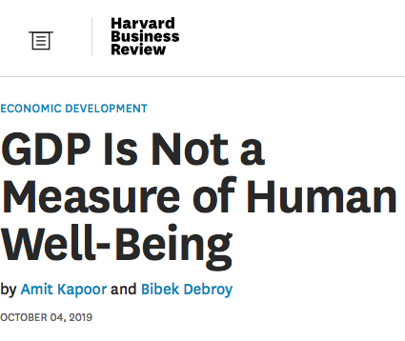
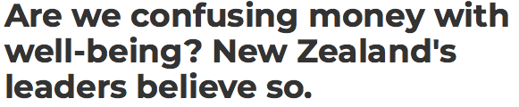
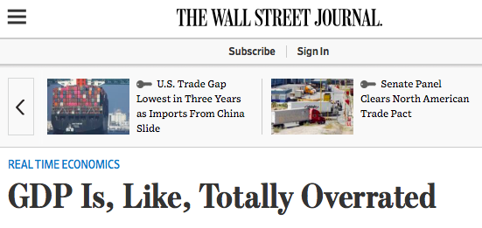


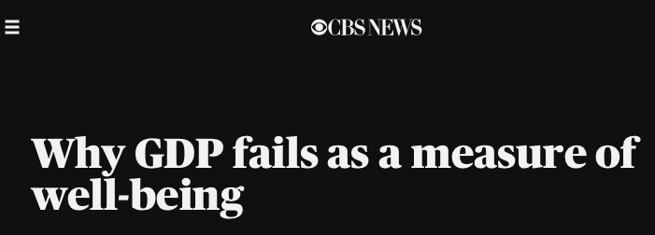
Beyond GDP

Slide 12
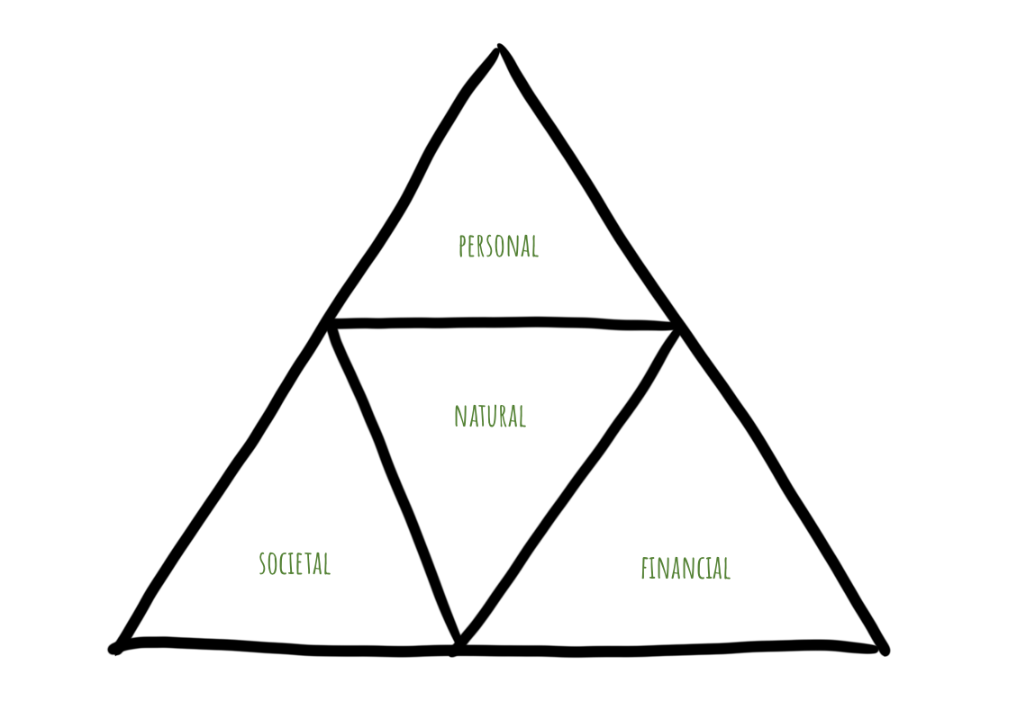
Ecological Civilization

Slide 13
Wat is de Betekeniseconomie definitie?

Slide 14
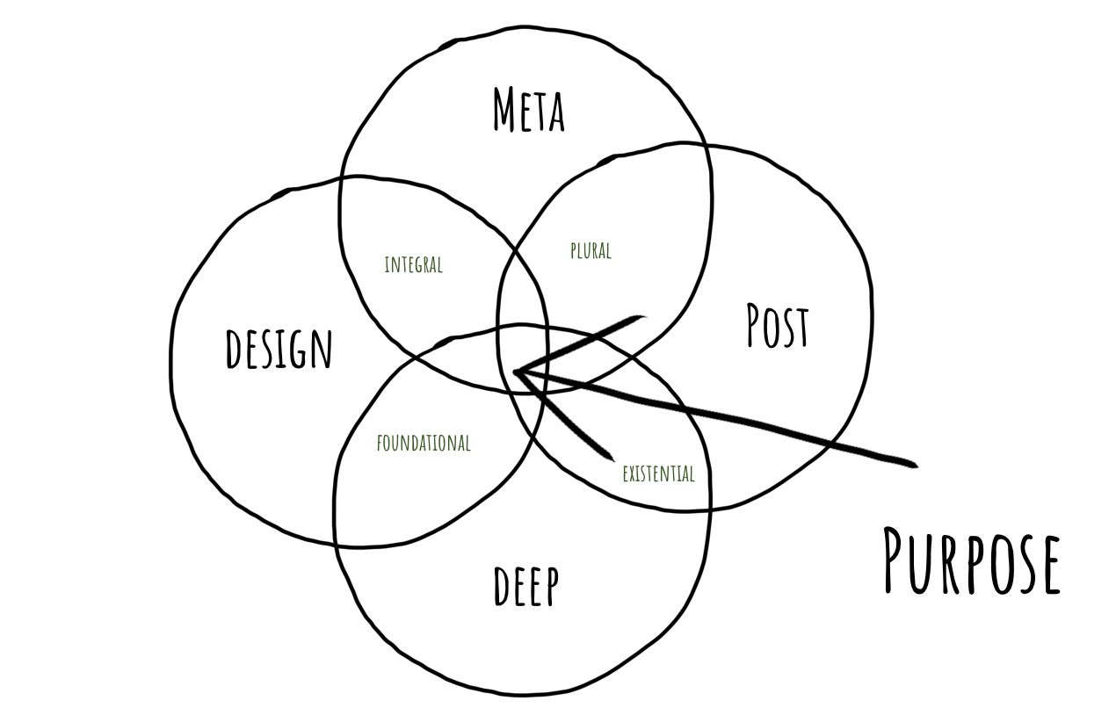

Slide 15
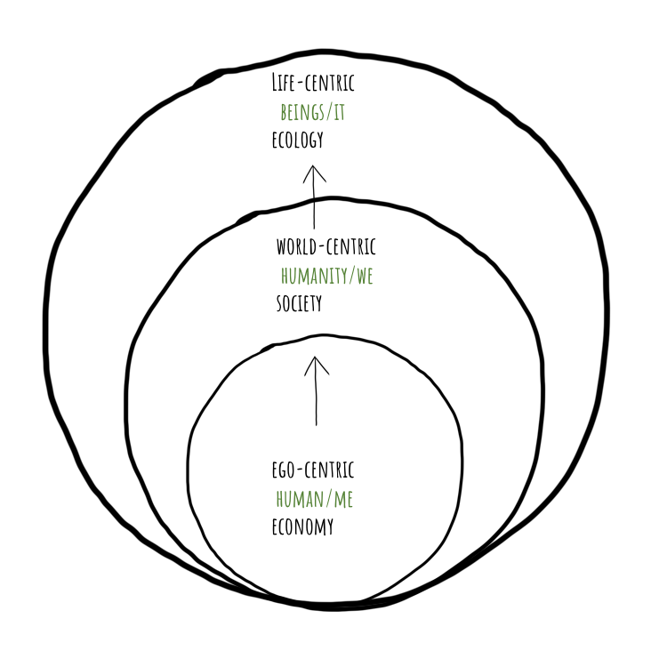
Meta Economics

Slide 16
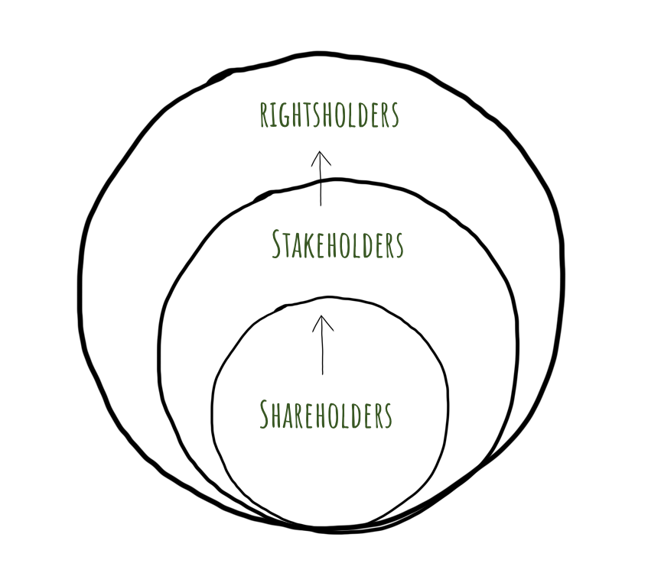
Integral

Slide 17
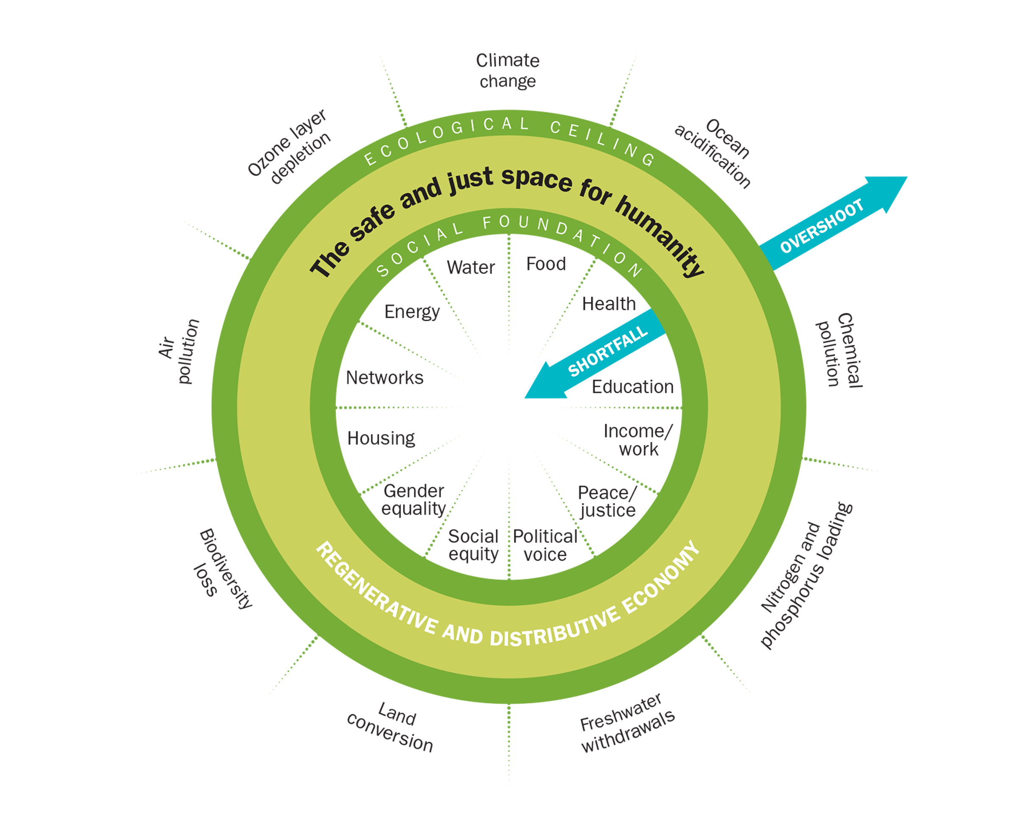
Design Economics

Slide 18
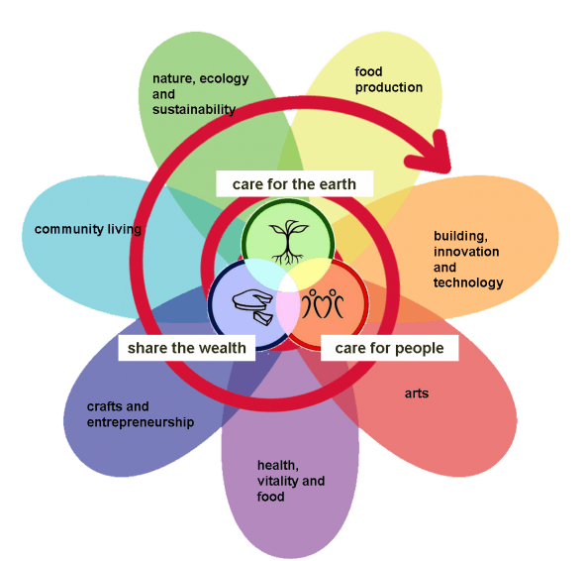
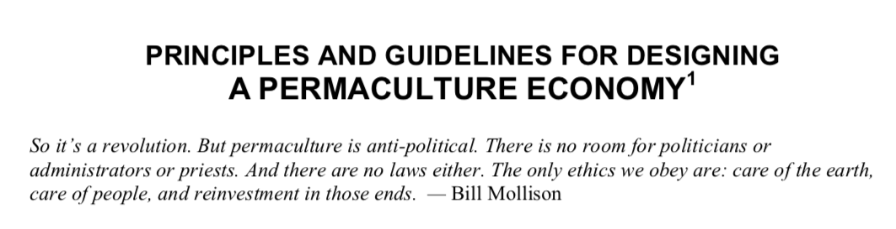
Foundational

Slide 19
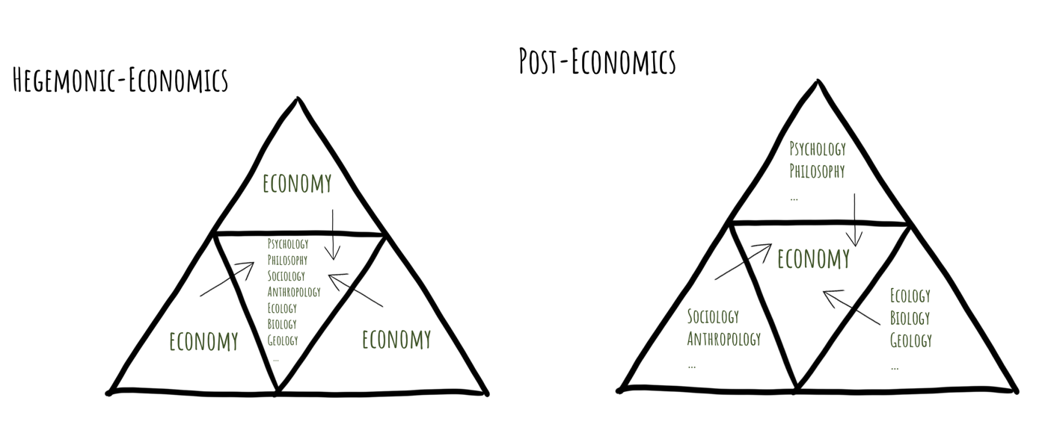
Post Economics

Slide 20
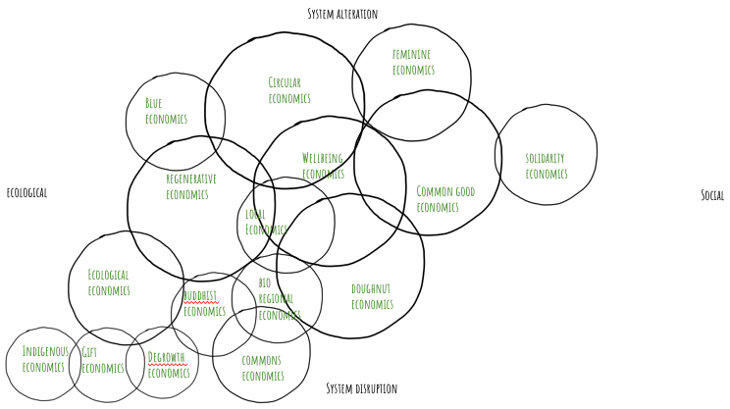
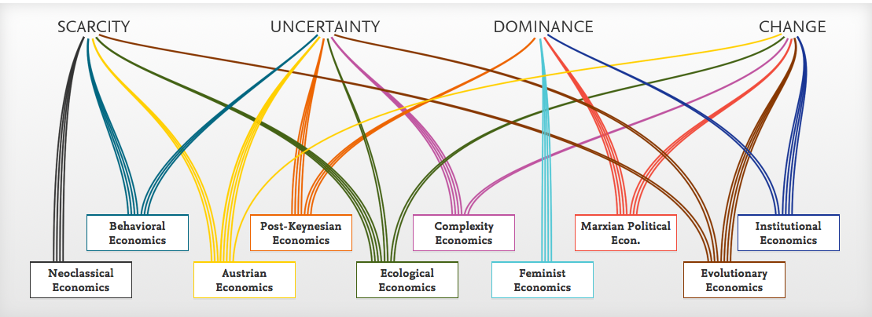
Plural

Slide 21
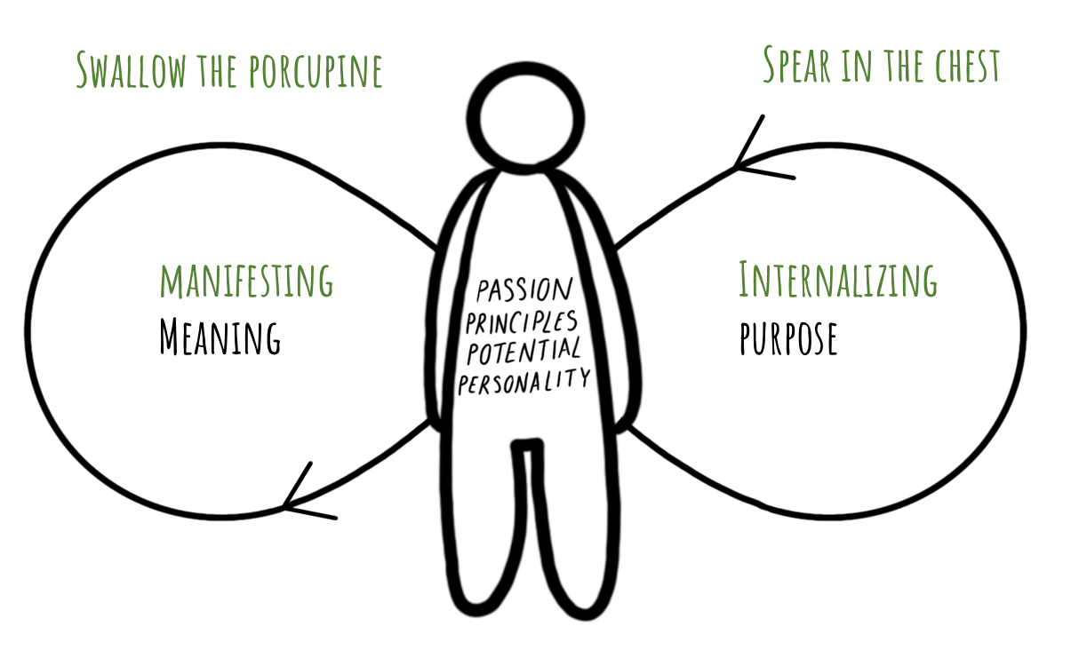
Deep Economics
Micro
Meta

Slide 22
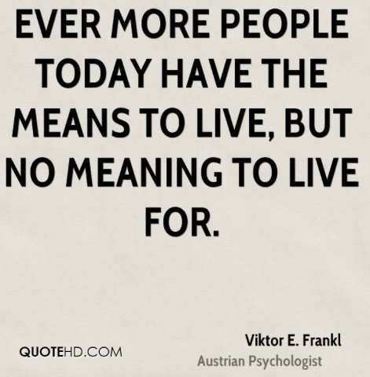
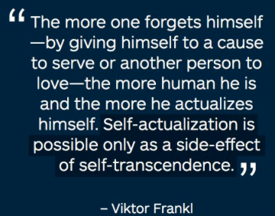

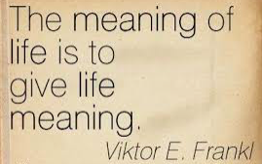
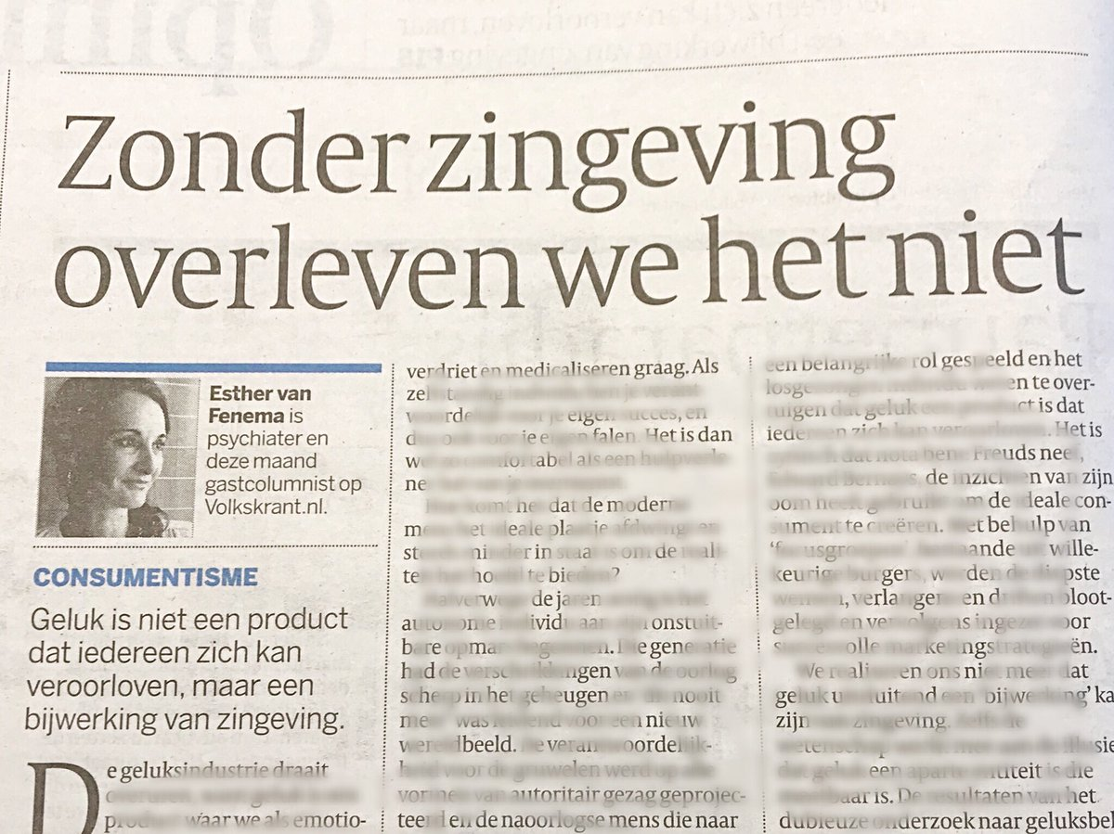
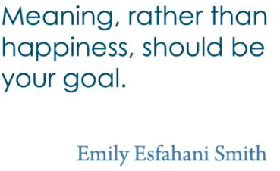
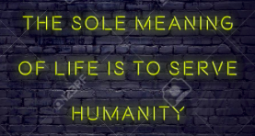


Existential

Slide 23

Purpose
Natural
Personal
Societal
Transcendental
Expansion of Economics
  A meaningful life
  An ecological civilization
  A wellbeing society
  A sustainable economy
Financial
Personal
Natural
Societal
Financial

Slide 24
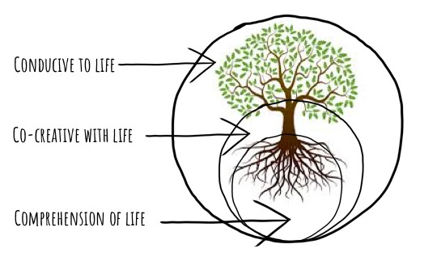
Thrive
In service of life
  Life strengthening
  Life affirming

Slide 25
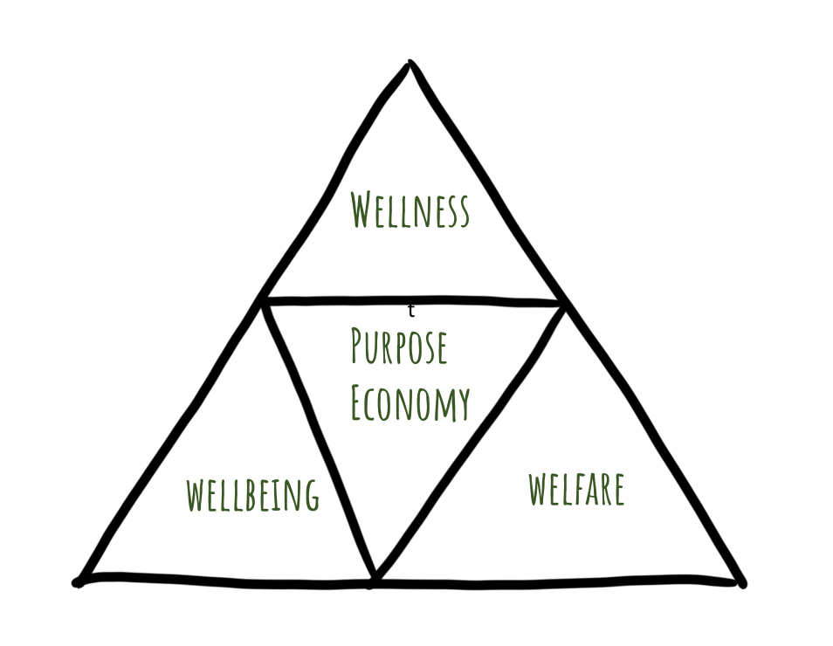
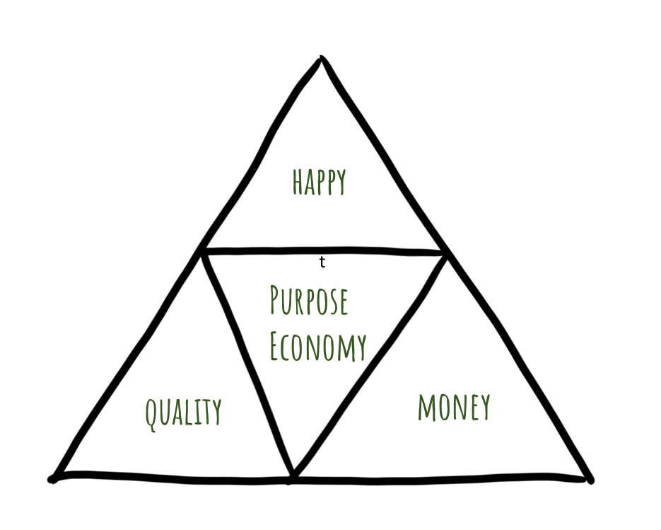
Country/company management
based upon achieving a flourishing
balance between welfare
(economical value, living standard),
wellbeing (objective societal value,
living environment) and wellness
(subjective personal value, living
conditions)

Slide 26
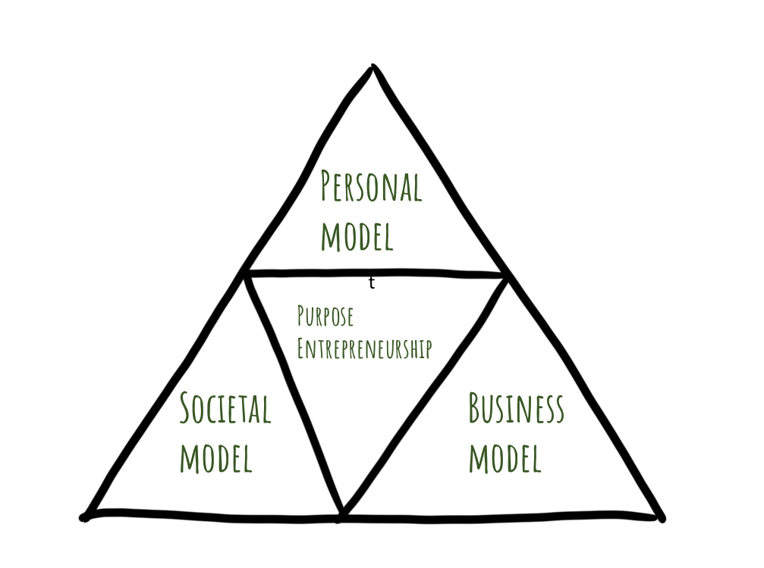
Combining the pursuit of
business effectivity with
societal and personal effectivity

Slide 27
Hoe herkennen we de
Betekeniseconomie?

Slide 28
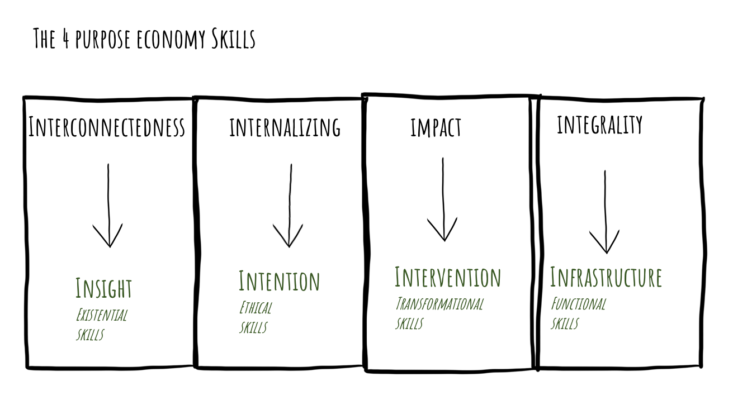
New Skills

Slide 29
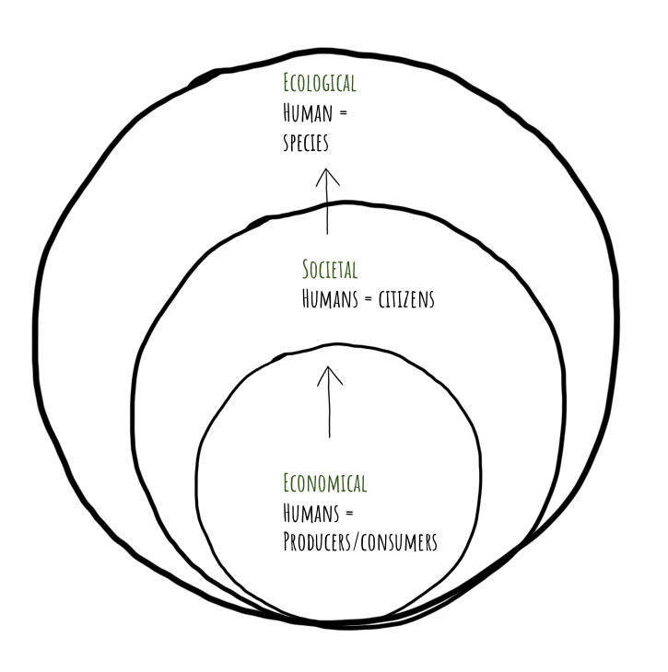
1) Recognizing the bigger picture

Slide 30
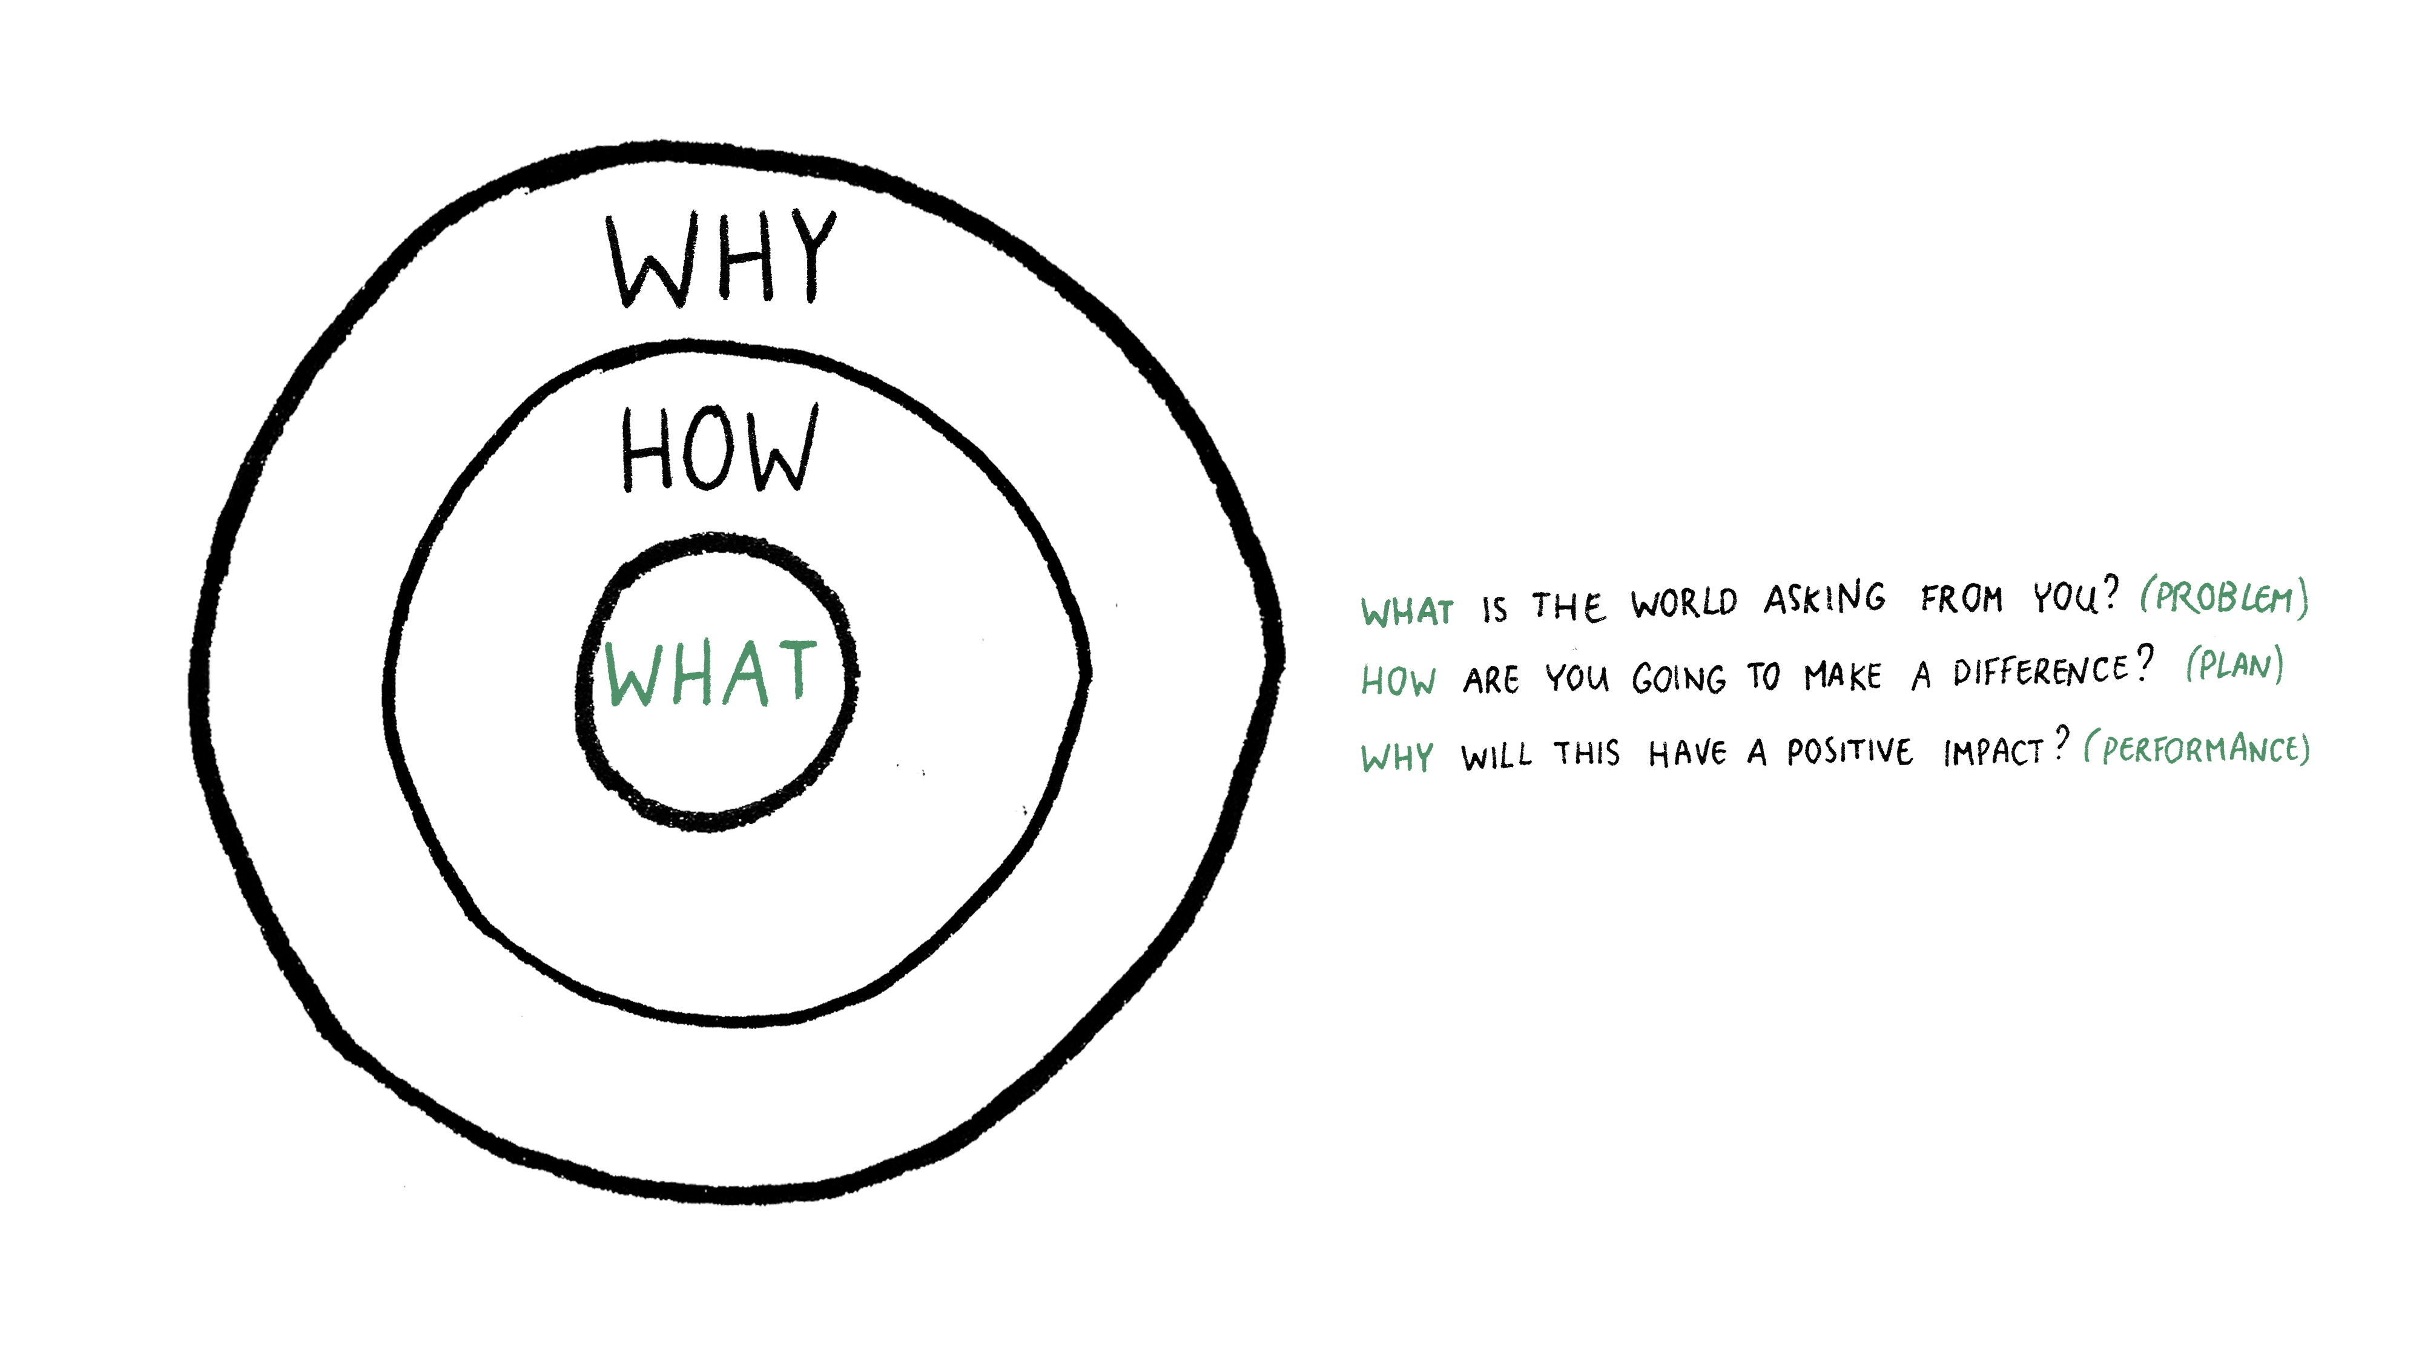
2) Making societal personal

Slide 31

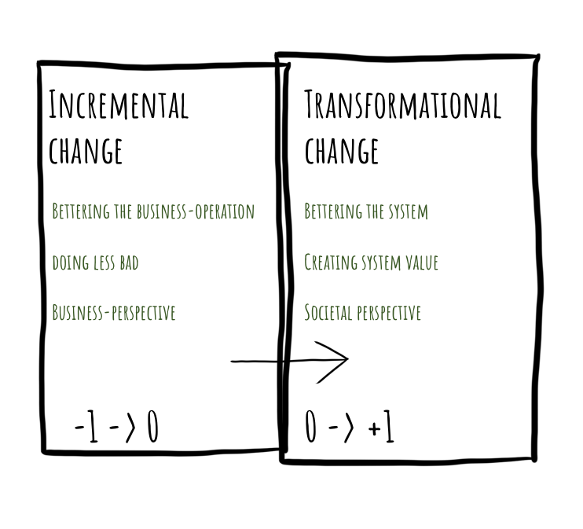
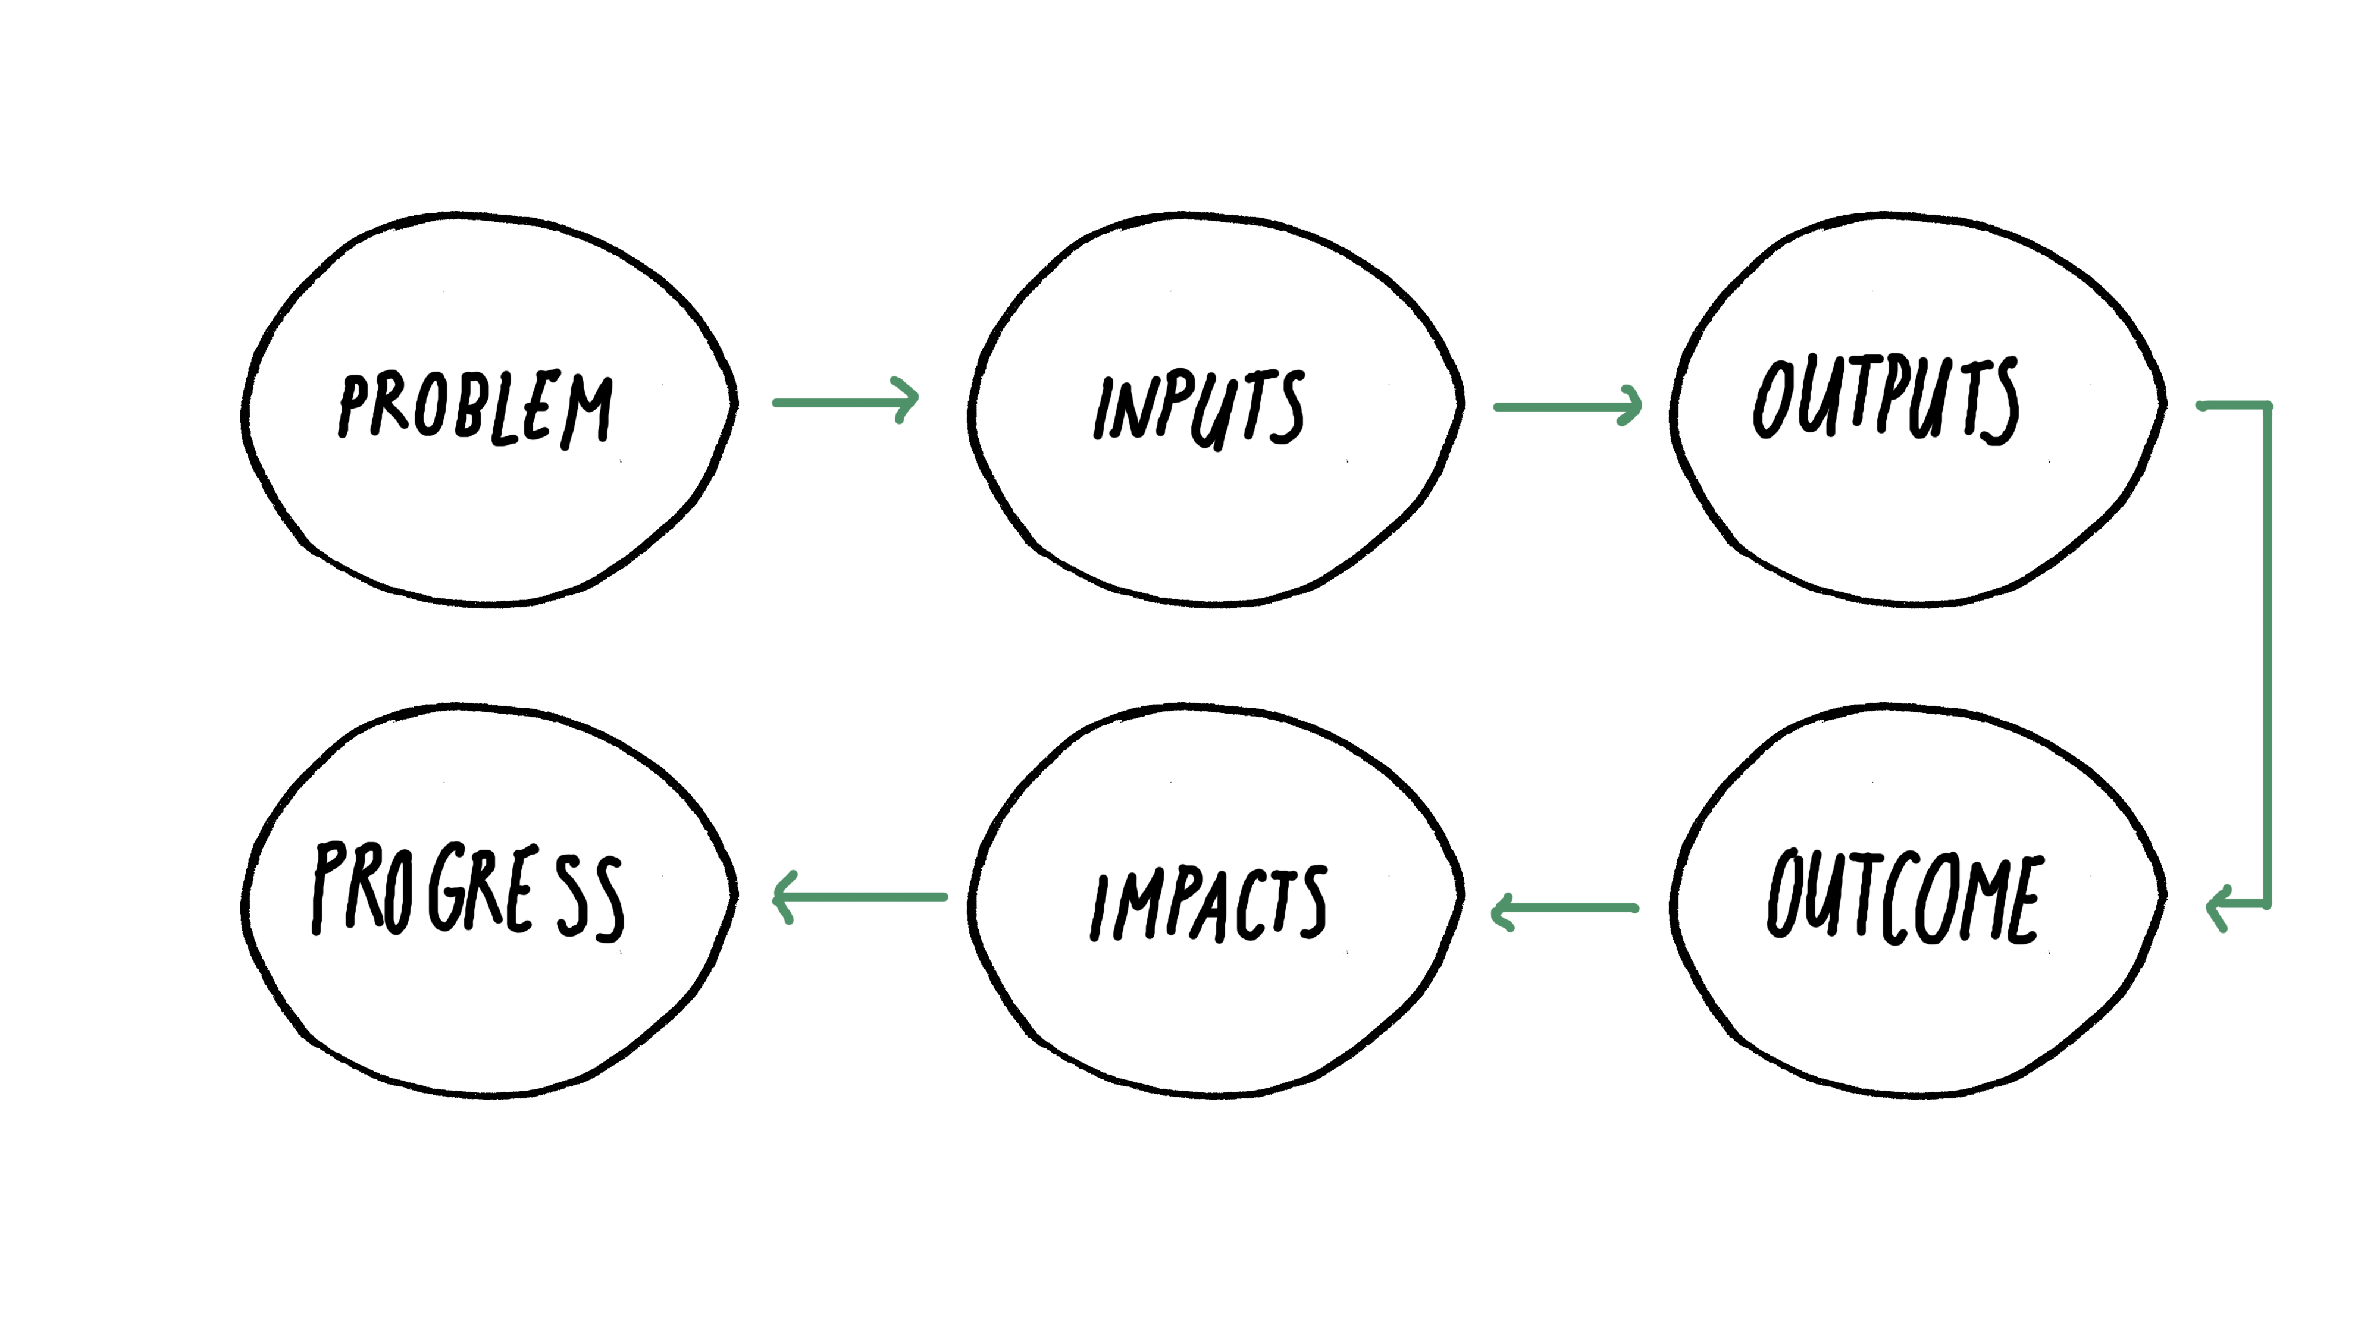
3) Making a difference

Slide 32
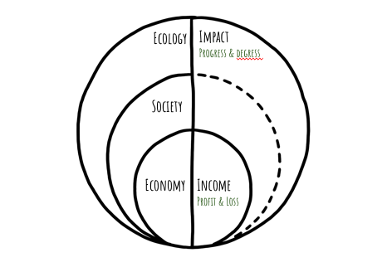
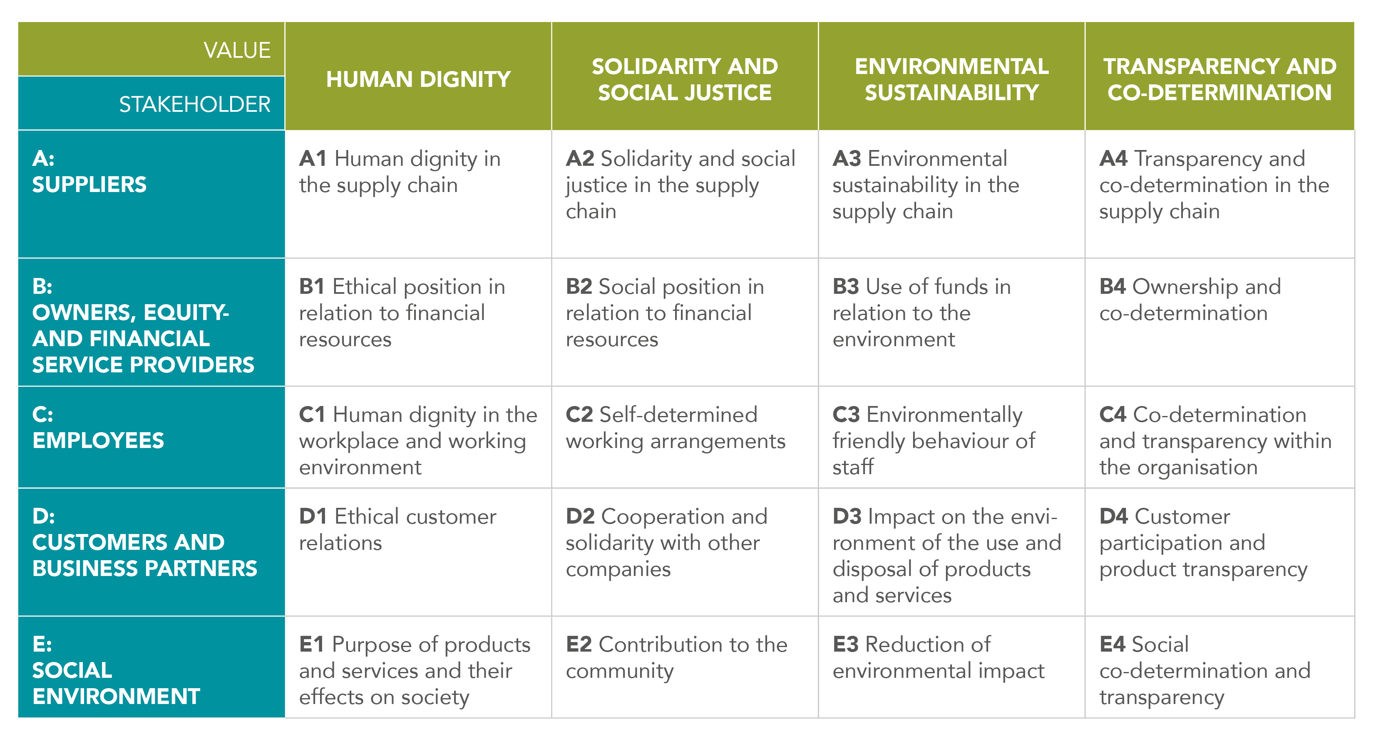
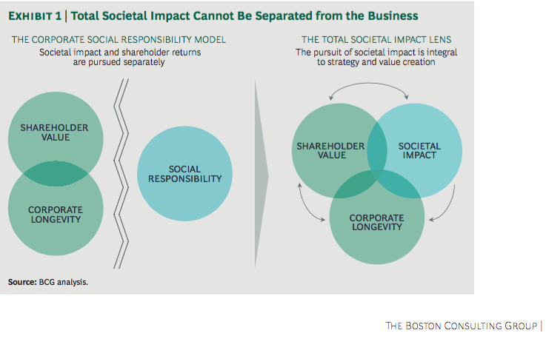
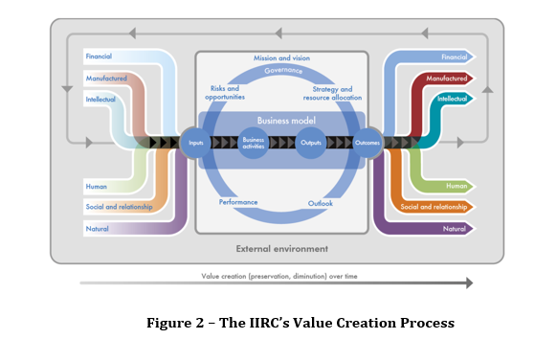



4) Accounting the
Integral company value

Slide 33
Hoe realiseren we een transitie richting de Betekeniseconomie?

Slide 34
Debunking/Diabiasing
Amplition
Voluntarism
Imagination
Appreciative Inquiry
Multidisciplinary
Transformational learning

