Slide 1


Welkom bij Anglia
Sander van Haarlem

Slide 2
Bent u al bekend met Anglia?

Slide 3
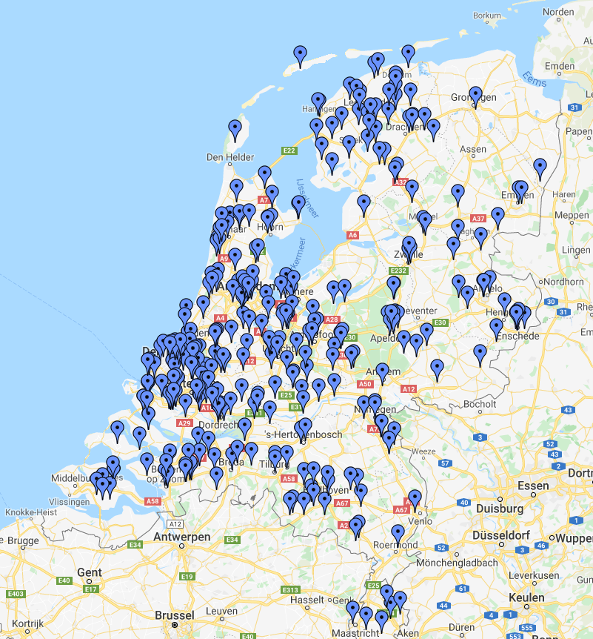
Anglia Schools
350 Anglia Member Schools in Nederland
  Basisscholen, voortgezet onderwijs en verder.
20,000 studenten per jaar
Wereldwijd in 42 landen
Nederlandse Anglia kantoor in Roosendaal
Hoofdkantoor in Chichester, UK

Slide 4
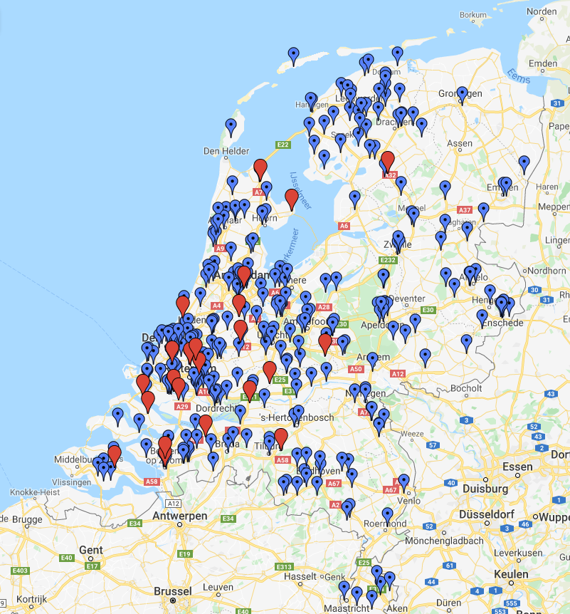
Anglia & VECON Business Schools
350 Anglia Member Schools in Nederland
  Basisscholen, voortgezet onderwijs en verder.
20,000 studenten per jaar
Wereldwijd in 42 landen
Hoofdkantoor in Chichester, UK
23 van de 79 VECON Business Schools zijn Anglia school.

Slide 5
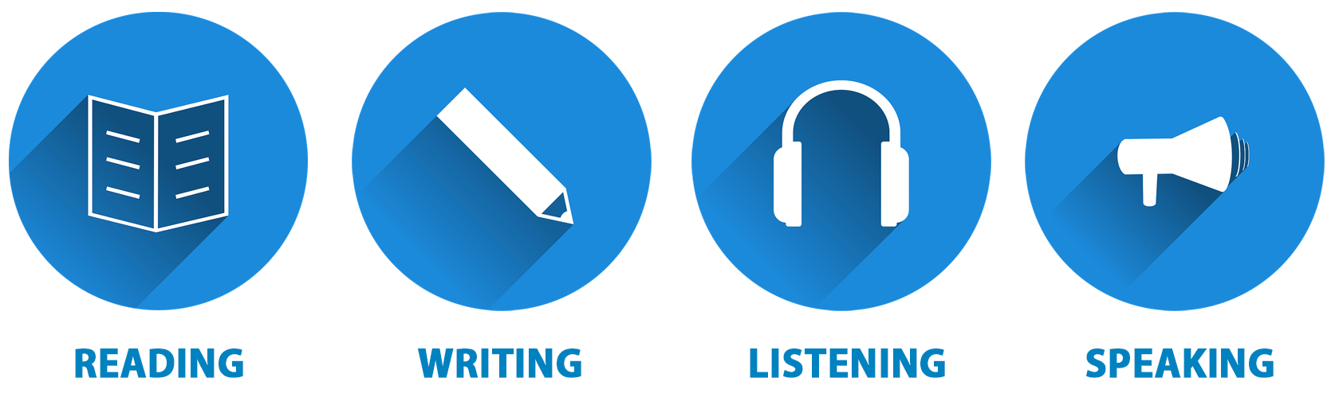
Anglia examens
Stap voor stap naar succes!
Stapsgewijs aanbieden en toetsen
Iedere deelnemer op zijn / haar eigen niveau:
  - Extra uitdagen of extra support
  - Succeservaring beleven
Scholen bepalen zelf hoe en voor wie Anglia wordt ingezet
Examens op school, nakijken in UK

Slide 6
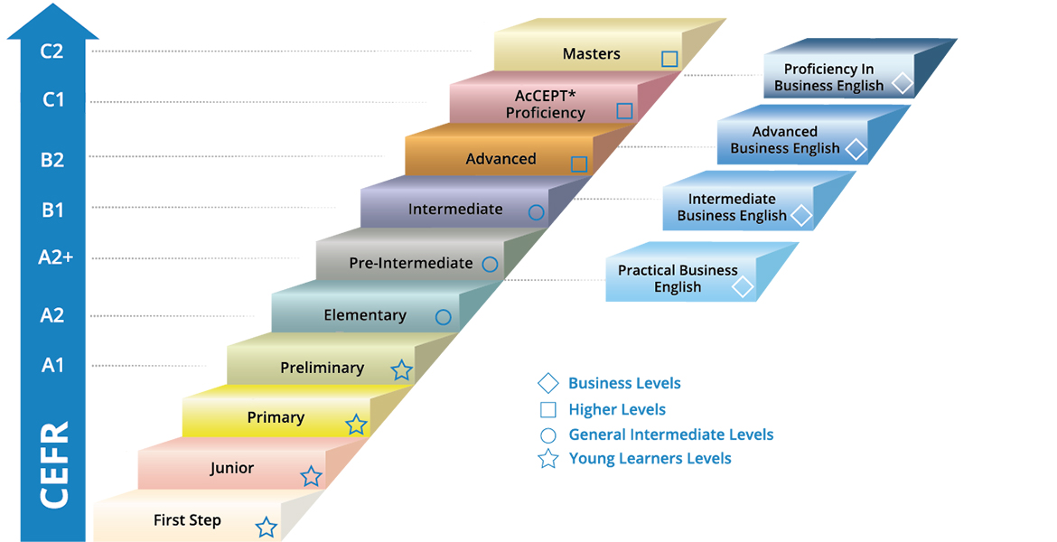
Anglia Levels
10x General English en 4x Business English

Slide 7
Anglia Levels
10x General English en 4x Business English

Slide 8
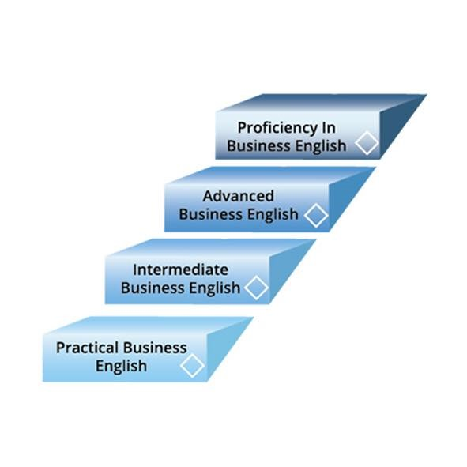
Anglia levels
Business English
4 Anglia Business English Levels
  Practical Business English (A2)
  Intermediate Business English (B1)
  Advanced Business English (B2)
  Proficiency in Business English (C1)
Onderwerpen zijn afgeleid van
  General English level equivalent
Geschikt voor brede groep leerlingen
5 examenmomenten per schooljaar
Platform in ontwikkeling
In tegenstelling tot de Anglia General English
  Levels worden de Business English levels op
  de computer gemaakt.

Slide 9

Practical BE | Intermediate BE | Advanced BE | Proficiency in BE
In a typical office or workplace context, the student can: listen to, understand and record practical factual information given in message form deal with basic social situations, such as making introductions, asking/giving permission, showing gratitude deal with the basic methods of modern office communication i.e. write an accurate email from information provided; write an appropriate email response to an enquiry | In a typical business or work-related environment, the student can: pick out relevant information from a conversation or exchange and accurately record it deal with the common exchanges of a business environment, both functional and social such as making an arrangement, confirming an appointment, making introductions manipulate basic data deal with the basic methods of modern office communication i.e. write a plausible and coherent email; respond to a message | In a typical business environment, the student can: listen to, pick out and record relevant information from an authentic context read and manipulate a variety of written forms of business communication including letter, note, email, newspaper article deal with a longer business-related text; provide an accurate summary of key points respond appropriately in a typical business conversation or exchange | In a typical business environment, the student can: follow presentations or exchanges typical of business meetings and accurately convert information from them into an acceptable graphic representation summarise information from a wide range of different spoken and written sources deal with longer, complex business texts write a coherent, structured report control the language of business and manipulate it for specific purposes

Slide 10

Anglia levels
Business English
Anglia Membership
€ 150,= per locatie per schooljaar.
Scholen die lid zijn van Anglia ontvangen 10% korting en betalen geen administratiekosten
Practical Business English
€ 37,50 / € 89,00
Intermediate Business English
€ 45,00 / € 102,50
Advanced Business English
€ 65,00 / € 110,00
Proficiency in Business English
€ 85,00 / € 116,50

Slide 11
Vragen?
sander@anglia.nl
0165-235320

