Slide 1
VECON study day 2019: « Economy in Transition »
Rethinking Economics Workshop.
21 March 2019
Pluralism in Economics Education

Slide 2
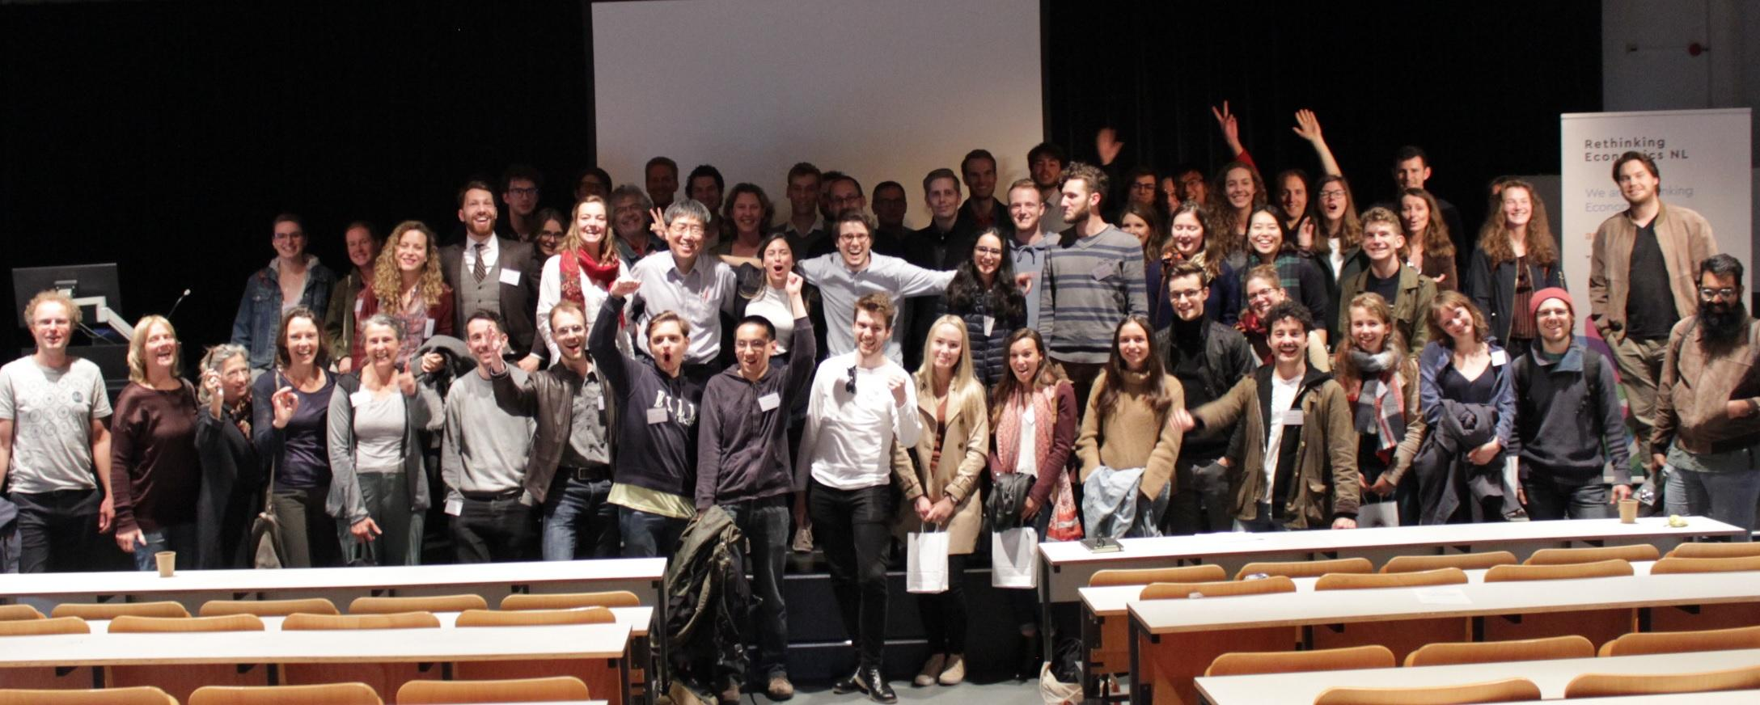
We are Rethinking Economics!
Notes:
My name is Clara and together with Mikal and Nils, I work as a core member for Rethinking Economics Netherlands.
Rethinking Economics is a worldwide movement and association that aims to diversify and reinvigorate Economics.

Slide 3
Outline
Introduction to Pluralism
Towards a pluralist High School Syllabus
RE:NL, Why our mission matters
Notes:
Quick outline: 1 min

Slide 4
Introduction to Pluralism
Why students should be taught pluralistic economics?
Notes:
Ask the Professors their definition of pluralism
Why according to them is Rethinking Economics advocating for more pluralism
Around 4 answers max then move on

Slide 5
Pluralism in Economics
Foundations of Economics
(History of Economics)
Heterodox Economics
Interdisciplinarity
Understanding the Economy
Mainstream Economics
Real World Examples
Recognition of these models strenghts & weaknesses
Notes:
The dominance of a single theoretical approach to economics creates blind spots and one-sideness. = This can turn to be problematic when studying the complexe and multidimensional phenomenon that characterizes the economy.
REAL LIFE EX : how to explain the 2007 economic crisis and avoid the possible next one?
We believe that combining different approaches and theories is required to gain anything close to a full understanding of the real Economy
We also believe that Pluralism is essential if we wish to give students the opportunity to grow as critical and independent thinkers.
To reach this goal
HOET
Use of both heterodox and mainstream theories and eco models
Recognition of their strenghts and weaknesses
Real world examples
Interdisciplinary approaches

Slide 6
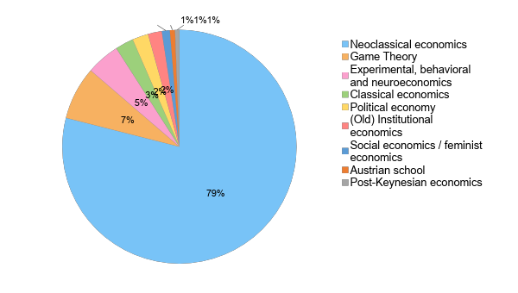
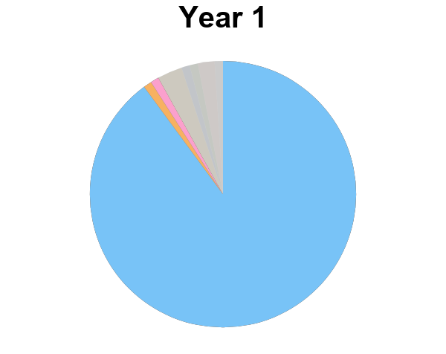
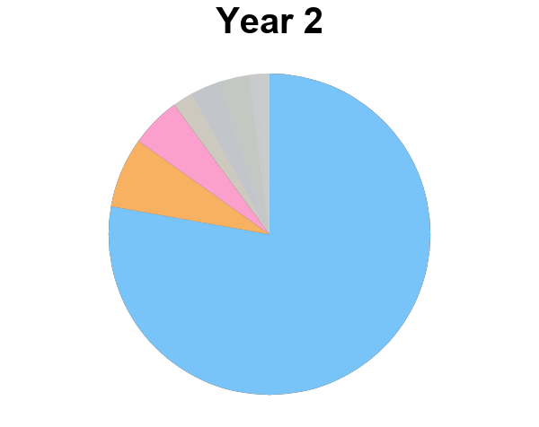
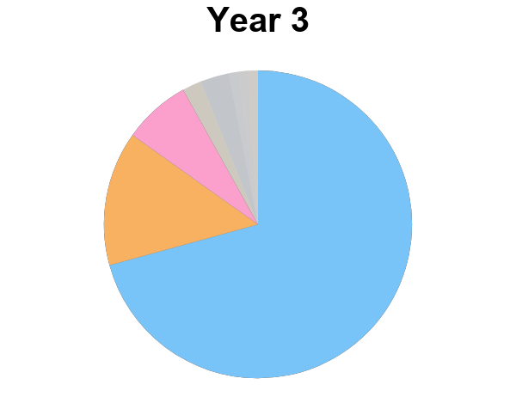
Diversity of Undergraduate Economic Education
This is what we observe at University…
Can we also observe this lack of Pluralism at High School?

Slide 7
Towards a Pluralist Economic Syllabus

Slide 8
The High School Curriculum:

Slide 10
Syllabus ≠ Teaching

Slide 11
Suggestions:
Pluralism, Real-World,
Interdisciplinarity
Notes:
Curriculum and Teaching: so how could the syllabus be changed to include more pluralist insights and how could one change the

Slide 12
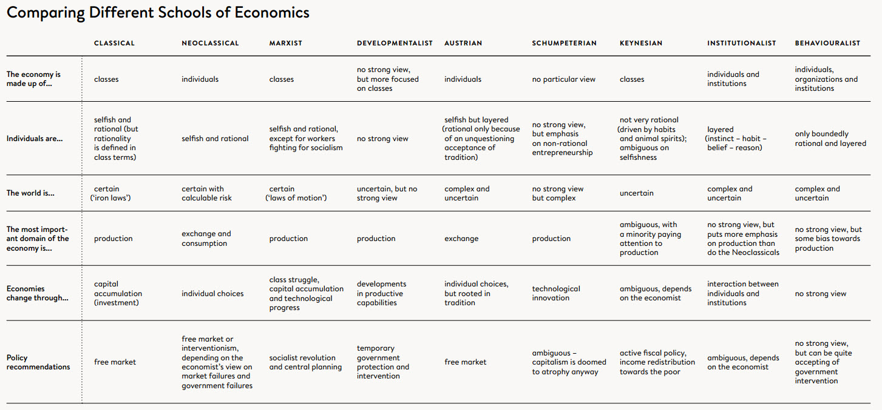
Pluralism: Introducing different Schools of Thought
Notes:
seeking to integrate psychological insights into economic theories → has thereby largely challenged the most common ,,mainstream approaches”: Herbert Simon and Prospect Theory and Daniel Kahnemann & Amos Tversky
Richard Thaler
right now the field of behavioral economics has becomen absolutely essential to modern economics → especially in the netherlands there are major research centers sich as Creed in Amsterdam or Tilburg with world class researchers dedicated to solve these problems →

Slide 13
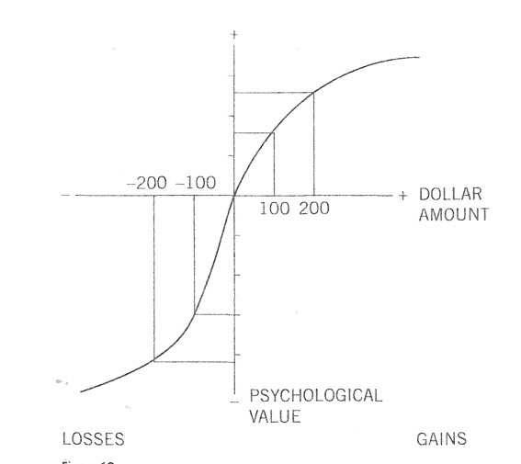
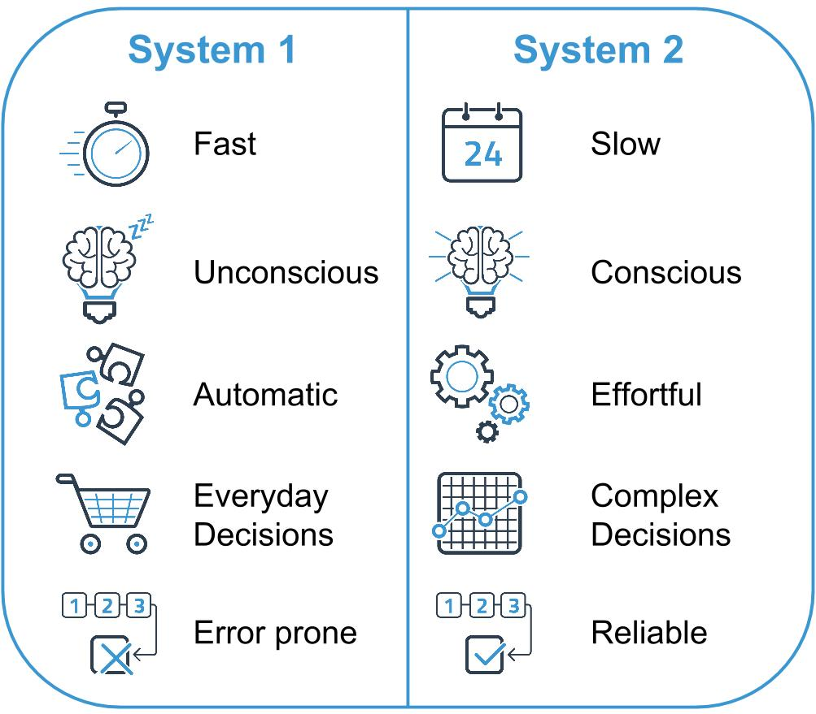
Behavioural Economics: Economie in Transitie

Slide 14
Integration into the Curriculum:
→ ,,Samenwerken en Onderhandeln” → Speltheorie
→ ,,Risico en Informatie” → risk averseness, assymetric information → endowment effect
Material: https://www.econedlink.org/resources/how-to-use-the-behavioral-economics-lessons/

Slide 15
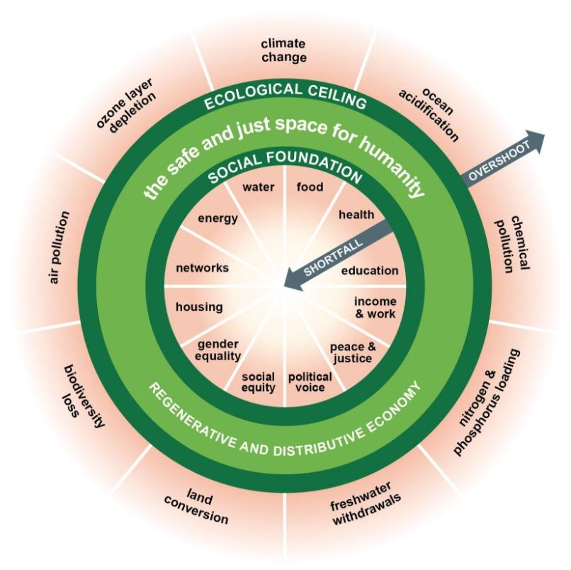
Example: Doughnut Economics

Slide 16
More Information on Schools of Thought:
https://www.exploring-economics.org/en/

Slide 17
2. Economic History and History of Economic Thought:
Economic History ≠ History of Economic Thought
“Too few economists newly arriving in the financial world have any real knowledge of events that, while sometimes in the distant past, may have tremendous relevance for current affair. The global financial crisis can be more easily interpreted and understood by someone who has prior knowledge about the 1929 crash, the Great Depression and, for that matter, the 1907 crash” (Stephen King, HSBC)
Notes:
awareness of the historical context of ones economic theories: need to figure out the text

Slide 18
2. Economic History and History of Economic Thought:
→ cooperation/integration in history classes
→ restructuring of ,,Goede Tijden, Slechte Tijden”, ,,Groei”
Ressources:https://www.fpri.org/article/2011/01/economics-in-history-what-every-high-school-student-and-teacher-needs-to-know/ (see table at the end)
Notes:
awareness of the historical context of ones economic theories: restructuring this course as it presents many concepts that are associated with a certain school of thought or
Knowledge of economic and financial history is crucial in thinking about the economy in several ways.
second, related point is that economic history teaches students the importance of context.
Finally, and perhaps most importantly from the perspective of an undergraduate economics instructor, economic history is a great way of convincing undergraduates that the theory they are learning in their micro and macro classes is useful in helping them make sense of the real world

Slide 19
3. More Interdisciplinarity- New Goals
New Interdisciplinary Challenges:
→ Societal Problems of the 21st century are fundamentally interdisciplinary e.g. Climate Change, Populism
→ intersection between politics, economics, law…….
2. Critical Thinking:
→ judge, analyse and know the limitations of economic reasoning (see behavioural economics, ,,Onderzoek en Experiment”)
Notes:
writ text for this tomorrow and maybe/possibly expand on it a bit further
limits: ties back to behavioral econ and

Slide 20
MORE “REAL-WORLD ECONOMICS”
What:
→ Economic History (again)
→ Economic sectors (How is the Dutch Economy structured?)
→ Economic problems (current affairs etc.)
How:
→ press articles, media
→ books, documentaries...

Slide 22
Our resources
https://www.economicseducation.org
https://www.economieonderwijs.nl/
https://www.exploring-economics.org/en/

Slide 23
Follow up :
Receive our report “Thinking Like an Economist”
Access teaching resources & monthly newsletter
Stay updated on our next events
Leave us your Email.

Slide 24
Thank You

