Slide 1
Ontwikkelingen in de boekhoudtechnologie
VECON 15 maart 2024
Wim Maas
Notes:
Crypto:
Wie bezit cryptocurrencies?
Wie kent de technologie van cryptocurrencies?
Wie weet hoe een blockchain werkt?

Slide 2
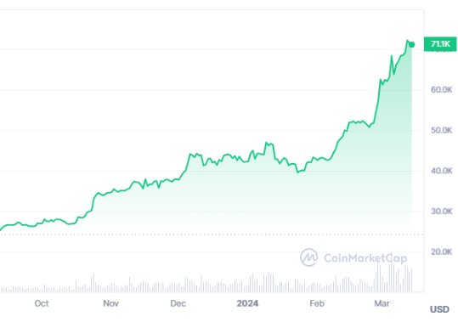

Notes:
Crypto:
- Wie kent de technologie van cryptocurrencies?
- Wie weet hoe een blockchain werkt?
- Wie weet hoeveel bitcoin uitgegeven is op dit moment?
- Wie bezit cryptocurrencies?

Slide 3

Wim Maas
Docent, Tilburg University
w.g.m.maas@tilburguniversity.edu
Notes:
Wie zijn jullie?

Slide 4
Programma 15 maart 2024
Geschiedenis
Boekhouden
De revolutie

Slide 5
Wat willen leerlingen weten?
Hoe word ik rijk?
Notes:
We komen hier later op terug.

Slide 6
Wat moeten leerlingen weten?
Wat is een cryptomunt eigenlijk?
Hoe werkt het?
Waarom is beleggen erin risicovol
Voor wie is die beleggingscategorie geschikt?
…
Notes:
Discrepantie betekent rol voor de docent

Slide 7
Crypto’s in het (b)eco curriculum?
Monetaire Economie
Schaarste
& Ruil
Crypto
Boekhouden
Beleggen
Notes:
Economie: Domein B (schaarste), Domein C (ruil), Domein I (specifiek I.4 geld)
Bedrijfseconomie: Domein B (specifiek B1 beleggen), Domein F (boekhouding)

Slide 8

Geschiedenis
Pt. 1
Notes:
The Bitcoin network launched in 2009. However, it didn’t appear out of thin air. There is actually a whole history behind the idea of electronic money. I will explain that there were two pillars the invention of Bitcoin stood on.

Slide 9
Economen, cryptografen en vrijheidsdenkers
Friedrich Hayek : “spontaneous order”
Richard Stallman and the MIT AI-lab “hacker culture” in the 60’s and 70’s
David Chaum, UC Berkeley
Libertarianism “Libertarianism is a political philosophy that emphasizes individual liberty as its core principle. It advocates for minimal government intervention in personal, social, and economic affairs.”
Cypherpunks “A movement that advocated for the use of cryptography as a route to social and political change. Prominent members like Hal Finney, Nick Szabo, and Wei Dai are often cited for their contributions to the ideas behind Bitcoin.”

Slide 10
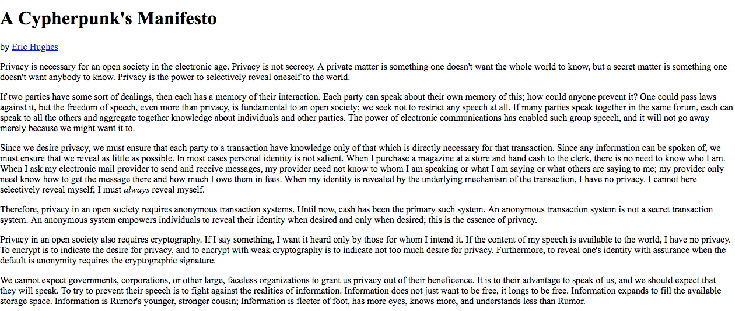
Hughes, Eric (1993), A Cypherpunk's Manifesto, archived from the original on 2021-03-24, retrieved 2002-02-25
Notes:
The idea to start Bitcoin or a digital form of money originated from a movement that started in the late 1980’s and was called the Cypherpunk movement. It was a group of activists that actively worked on ways to preserve privacy in the digital world. As we have seen last week in the facebook-gate, data has become power (literally). The cypherpunks recognized this very early on. This was a group of computer scientists including some of the brightest people of the world. This piece (A CYPHERPUNKS MANIFESTO) written in 1993 by Eric Huges has become a notorious stance on their principles. Let me quote a short piece that is relevant for this lecture: “Therefore, privacy in an open society requires anonymous transaction systems. Until now, cash has been the primary such system. An anonymous transaction system is not a secret transaction system. An anonymous system empowers individuals to reveal their identity when desired and only when desired; this is the essence of privacy.”

Slide 11
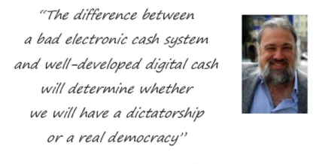
Pre-history
……
David Chaum’s “ecash” (1983)
Adam Back’s “hashcash” (1992)
Wei Dai’s “b-money” (1998)
Nick Szabo’s “bit gold” (1998)
- Attributed to David Chaum
Notes:
As said, there is a Cypherpunk pre-history attached to bitcoin. Bitcoin wasn’t the first attempt to create economic cash.
Ecash, making payments untraceable with the use of digital signatures
Hashcash, coming up with proof of work to prevent spammers in a network
B-money and bitgold, now having a limited supply and using hashes as proof of work and timesstamping
Bitcoin was a continuation of the work done by all these cryptographers and uses many of their Idea’s. These idea’s just had one problem they had not solved yet.
Double-spending problem: “How does one prevent that the same money is send twice?”. If I send an email, who has the email??

Slide 12
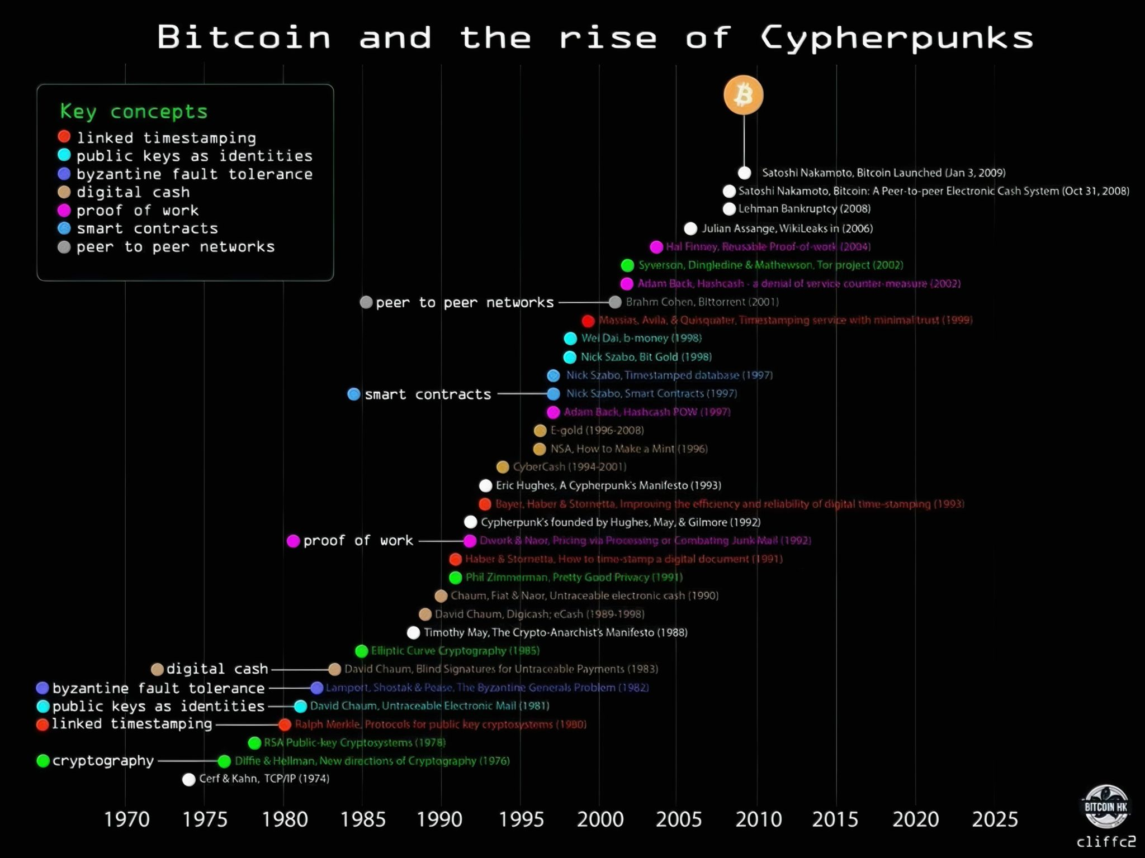

Slide 13
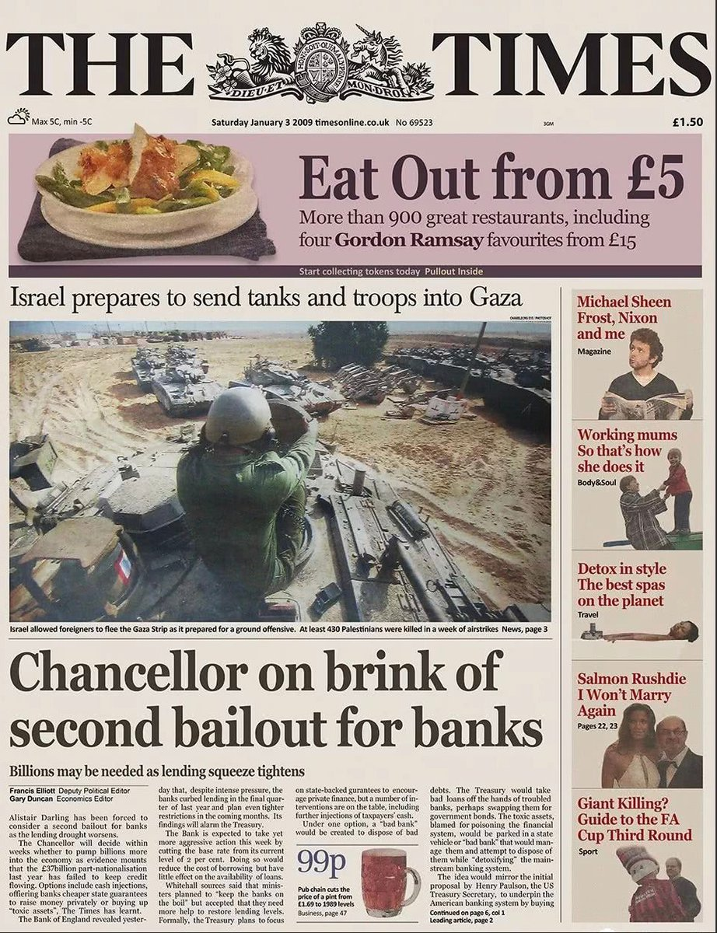
Notes:
The second premise for Bitcoin’s existence is the tight grip that governments and central banks enforce in the area of money. Governments and central banks protect the dominance and stability a, in the eyes of the Cypherpunks, inherently imperfect form of money which is the dollar/euro/pound. Since central banks control the money supply, your money devaluates each year due to inflation. Moreover, nowadays you don’t own your own wealth. Your bank owns it and owes it to you. Lastly, as we have seen after the 2008 financial crisis, governments are willing to use taxpayer money to bail out myopic behavior incentivized by fractional reserve banking. They actively bailed out banks with taxpayer money or even printed extra supply through quantative easing to buy up so-called “toxic assets”.
It was partly an outrage over this that Bitcoin was invented. A need for independency. This news article we see here has been made immortal, since the inventor of Bitcoin added it’s title as a sort of subscript to the inception of the Bitcoin database.

Slide 14
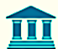
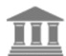



Hoe werkt een bank
Wat gebeurt er als je geld wil sturen naar een vriend?
Notes:
vordering

Slide 15
Wat doet de bank met je spaargeld?
Hoe ziet de balans van een bank er uit?
Van elke euro spaargeld, hoeveel denk je dat de bank zelf in kas/bank aanhoudt?
Notes:
EU Minimum reserve ratio = 1%

Slide 16
Wat als je …
…geen bankrekening hebt?
…niet wil dat de bank/overheid/belastingdienst/(…) meekijkt?
…niet wil dat jouw bank je geld belegt in de wapenindustrie?
…geld naar een ander ver land wil sturen?
…afgesloten bent van het financiële system (Noord-korea/Julian Assange)?
…het niet eens bent met de manier waarop fiatgeld bijgedrukt wordt?
…niet afhankelijk wil zijn van een bank of banken wantrouwt?
Notes:
1.4 miljard unbanked
Voorbeel julian assange (wikileaks)

Slide 17
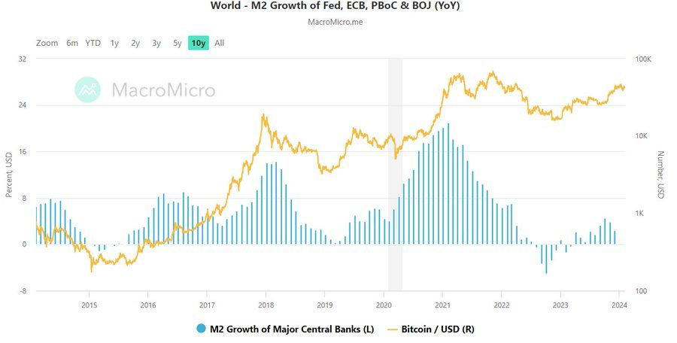

Slide 18
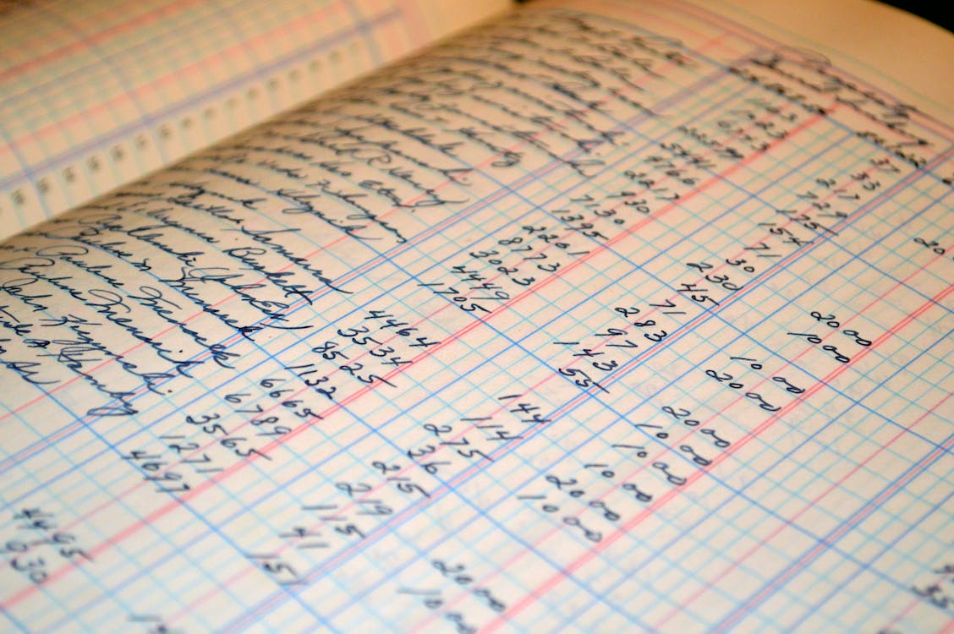
Boekhouden
Pt. 2
Notes:
The Bitcoin network launched in 2009. However, it didn’t appear out of thin air. There is actually a whole history behind the idea of electronic money. I will explain that there were two pillars the invention of Bitcoin stood on.

Slide 19




Inventions in accounting
Accounting is “the process or work of keeping financial records.”
First invention: Arabic numerical system (±500BC)
Second invention: Double entry bookkeeping (1494)
?
Notes:
Accounting is the process or work of keeping financial records
Arabic numerical system, which ironically enough was invented in what is now india
The second invention in accounting was double entry bookkeeping. Invented in 1494 by Luca Pacioli (mathematician)
This allowed tradesmen in that time to register their transactions and keep track of their assets. These books were updated by debits and credits, i.e. double entries
Who uses the books?
Internal function + external users (tax-authority, AND as of the 16th century shareholders
Accounting stayed like this

Slide 20
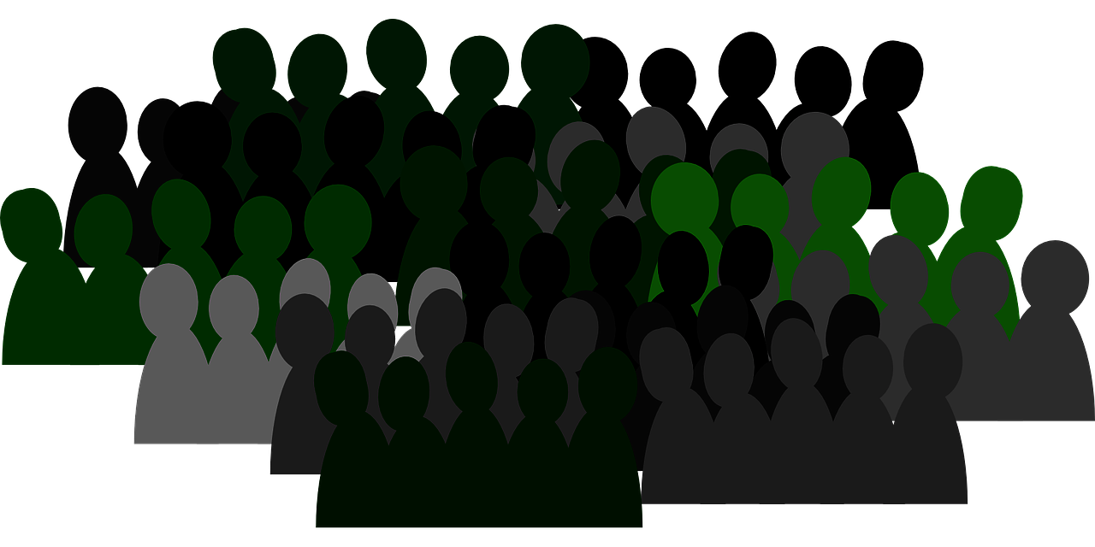
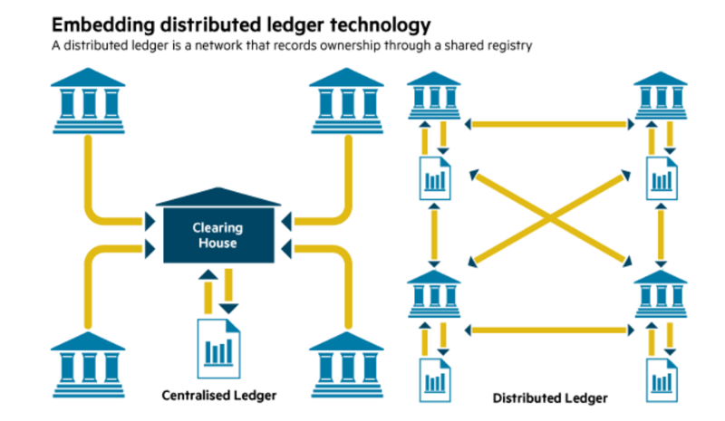



Flaws of centralized bookkeeping
??
Books are kept by people
Books are controlled by agents
Books are checked by people paid by agents
Books are kept separately
→ Costly, slow and unreliable
WIDER CHINA-HONG KONG DISCREPANCY REVIVES FAKE TRADE DOUBTS
Bloomberg News
January 26, 2016, 10:10 AM GMT+1
The gap between China’s reported exports to Hong Kong and the shipments registered into Hong Kong widened in December, suggesting currency-market swings may have spurred a fresh round of fake trade invoicing
Notes:
Books are kept by people (bounded rationality + self-interest)
Books are controlled by agents
Books are checked by people paid by agents = The wikipedia article “accounting scandals” contains almost 3 times as much words as the article “accounting”
Books are kept separately = Often books are not reconcilable. Tax authorities try to reconcile large transactions but that’s is. If you would add all financial assets in the world and all financial liabilities in the world you would probably end up with a big deficit. Another example we might have heard of is reported China’s export and reported import from China, which notoriously doesn’t add up.
To conclude, the current system of best practice (centralized double entry bookkeeping) is costly, slow and unreliable.

Slide 21
Decentralized bookkeeping
Satoshi Nakamoto’s (2008) blockchain: “A distributed ledger of transactions in virtual asset-ownership governed
by a shared protocol and secured by cryptography”
Notes:
Based on a concept called memory is money, which says that if one knows all transactions in history, one also knows the ownership state in the present.
This kind of bookkeeping can be applied for a digital representation of an asset
With transactions only being added to the network if they are conform a set of rules that everyone agrees to.
And they are signed by the sender’s so-called public key
The history of transactions stored by all nodes in the network and after that unchangeable.

Slide 22

De revolutie
Pt. 3

Slide 23
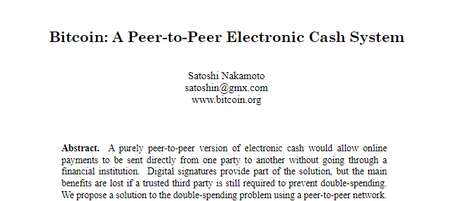
Notes:
In 2008 the Bitcoin whitepaper was sent through the famous cypherpunk mailing list. It was a proposition for a new currency, solving the double-spending problem.

Slide 24
Bitcoin, a peer-to-peer decentralized currency with fast transactions and low fees.
Promise

Slide 25
Bitcoin, a peer-to-peer decentralized currency with fast transactions and low fees.
Promise

Slide 26
…peer-to-peer…
Say you want to transfer money to your friend
Now:

Slide 27

…peer-to-peer…
Say you want to transfer money to your friend
With Bitcoin:
Notes:
Because anyone can verify ownership of the sender and legitimacy of the transaction, the middle-man is cut out.

Slide 28
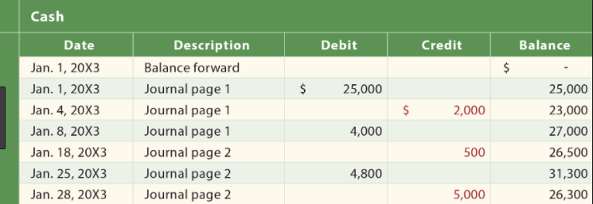
…decentralized…
“Money is memory” (Kocherlacota R., 1996): Any ownership-state of money can be known if one knows all prior transactions that ever occurred.
The only thing Nakamoto needed was a ledger everyone agrees on.
Notes:
Based on a concept called memory is money, which says that if one knows all transactions in history, one also knows the ownership state in the present.
This kind of bookkeeping can be applied for a digital representation of an asset, for example cash.
With transactions only being added to the network if they are conform a set of rules that everyone agrees to (the protocol)
And they are signed by the sender’s so-called public key
The history of transactions stored by all nodes in the network and after that is unchangeable.

Slide 29
…decentralized…
Satoshi Nakamoto’s (2008) blockchain: “A distributed ledger of transactions in asset-ownership governed by a
shared protocol and secured by cryptography”
Notes:
Based on a concept called memory is money, which says that if one knows all transactions in history, one also knows the ownership state in the present.
This kind of bookkeeping can be applied for a digital representation of an asset, for example cash.
With transactions only being added to the network if they are conform a set of rules that everyone agrees to (the protocol)
And they are signed by the sender’s so-called public key
The history of transactions stored by all nodes in the network and after that is unchangeable.

Slide 30
…decentralized…
Satoshi Nakamoto’s (2008) blockchain: “A distributed ledger of transactions in asset-ownership governed by a
shared protocol and secured by cryptography”
Notes:
Based on a concept called memory is money, which says that if one knows all transactions in history, one also knows the ownership state in the present.
This kind of bookkeeping can be applied for a digital representation of an asset, for example cash.
With transactions only being added to the network if they are conform a set of rules that everyone agrees to (the protocol)
And they are signed by the sender’s so-called public key
The history of transactions stored by all nodes in the network and after that is unchangeable.

Slide 31
Who decides on the history?
The history is broadcasted to all participants
Valid transaction is broadcasted
Proof-of-work mining process
Batch (block) is added to the history (chain)
New history is broadcasted to all participants
Notes:
As said everyone can send transactions to this ledger as long as these adhere to some rules.
Broadcast to the network
Who decides which transactions to add to the history is done based on a lottery (PoW)
Batched transactions are added to the blockchain
Every participant

Slide 32
Decentralized vs. centralized bookkeeping
Cost → Records can be updated electronically, saving the costs of intermediaries.
Speed → Records can be updated within 10 minutes.
Data Integrity → Data stored in distributed ledgers is immutable and inalterable.
Source: Yermack D., 2017
Notes:
Cost. Records can be updated electronically, saving the costs of banks facilitating transactions, lawyers changing land titles, or notaries counting votes. TRUSTLESS
Speed. Records can be updated within 10 minutes. In contrast, a company’s accounts may be updated only annually; counting votes takes a whole day.
Data Integrity. Data stored in distributed ledgers is immutable and inalterable. Land records can be falsified, corporate income statements can be manipulated, and option grants can be backdated. CENSORSHIP RESISTANT

Slide 33
Hoe vaak?

Slide 34
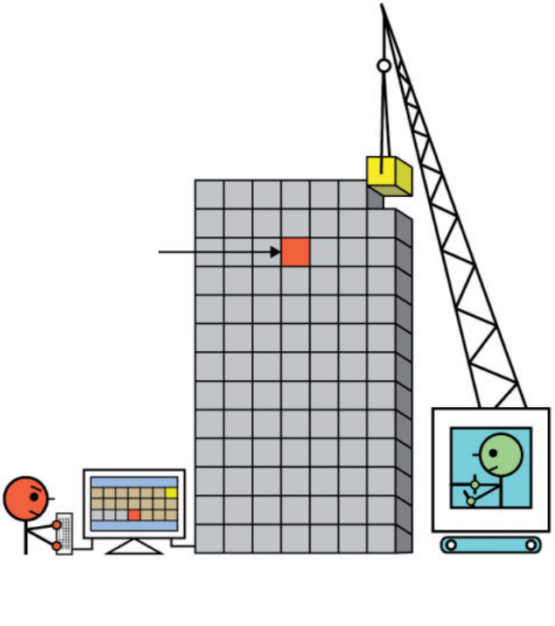
Want to hack bitcoin?
Say you want to alter block 74
All other miners are now computing block 91
Since a change in block 74 changes the hash in 75…
And a change in block 75 changes the hash in 76…
And a change in block 76 changes the hash in 77…
… etc.
You will have to find hashes for 18 consecutive blocks!
What’s worse, you will have to do this within 10 minutes
(Source: Yermack, 2017)

Slide 35
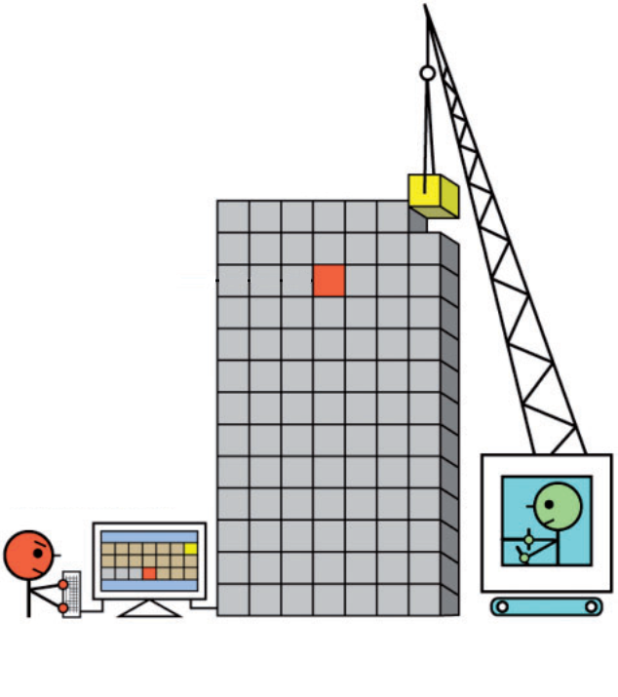
Want to hack bitcoin?
Say you want to alter block 91
All other miners are now also computing block 91
For your block to be accepted as the new block at least half of the other miners have to agree your block is valid.
This will thus only work if you control more than 50 percent of all bitcoin computing power in the world
This is called “a 51%-attack”
It has never happened…
(Source: Yermack, 2017)

Slide 36
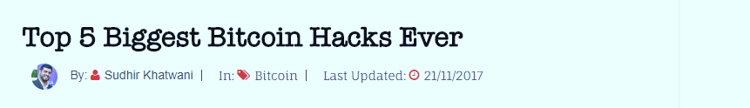
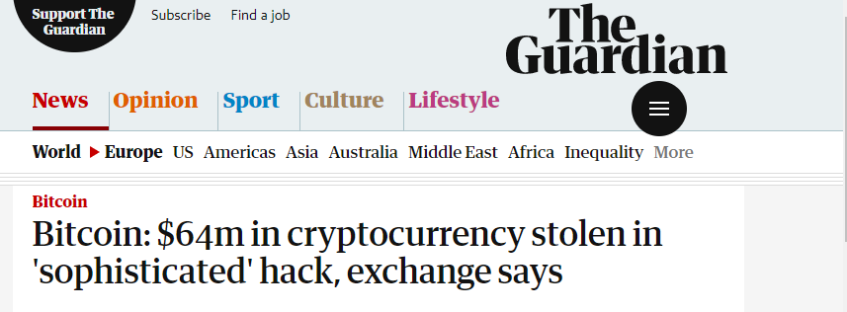
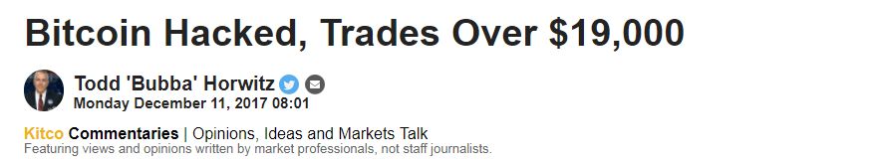
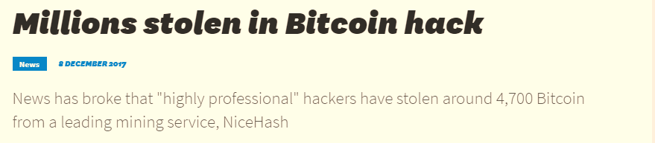
But I hear about bitcoin hacks all the time?

Slide 37
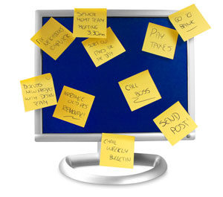

But I hear about bitcoin hacks all the time?
Say you leave your Facebook-password on a sticky note on your computer
The cable guy fixing your TV sees the password and accesses your account
Is Facebook hacked?

Slide 38
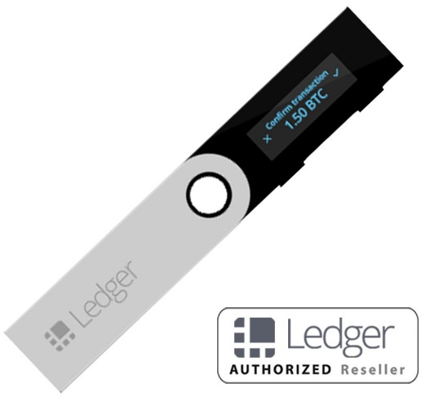
Where do you store passwords?
Where do you store your bank’s 4-digit PIN number?
E9873D79C6D87DC0FB6A5778633389F4453213303DA61F20BD67FC233AA33262
Notes:
Remember it? Good luck

Slide 39
Wallets, exchanges and private keys
How to access your bitcoin:
I have an account on an exchange
  Pro’s: Easy access, fast to sell
  Con’s: YOU DO NOT OWN YOUR BITCOIN (a trusted 3rd party does)
I have my own private key’s
  Pro’s: You own your bitcoin, fast transfer with other bitcoin users
  Con’s: To sell it you have to transfer it to an exchange first

Slide 40
…currency…
Wat maakt geld geld?
Functies van geld:
“ruilmiddel“, “rekenmiddel”, “spaarmiddel”
Opdracht mogelijk!!

Slide 41
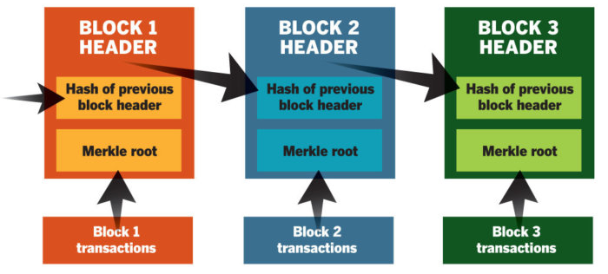
…with fast transactions…
Blocks are made by miners, expending CPU power to secure the network
Notes:
Blocks are made by miners, expending CPU power to secure the network through a protocol called PoW. They are rewarded for this work with newly minted bitcoin. Right now you can earn 12 bitcoin every 10 minutes by mining it. However, every 10 minutes only 1 node in the network gets this 12 bitcoin. It is like a lotery. Each block can fit roughly 3000 transactions, which means that unless there are too many transactions waiting your transaction can be processed with 10 minutes. A downside of the fixed blocksize of 1 MB is scalability.

Slide 42
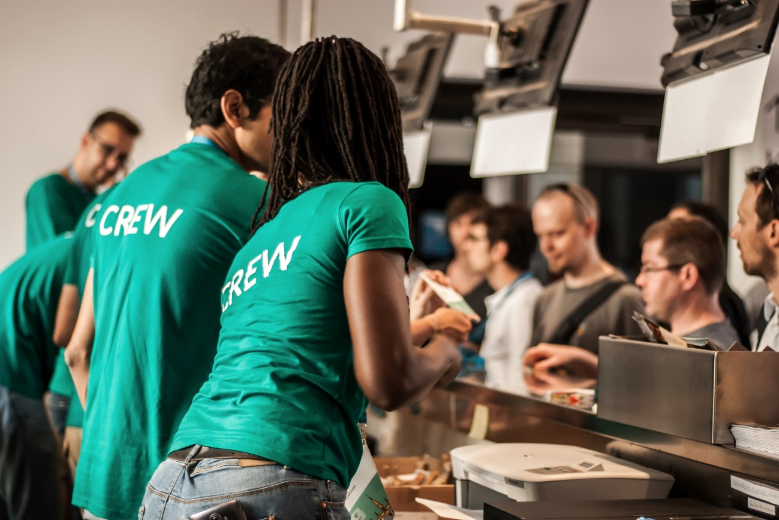
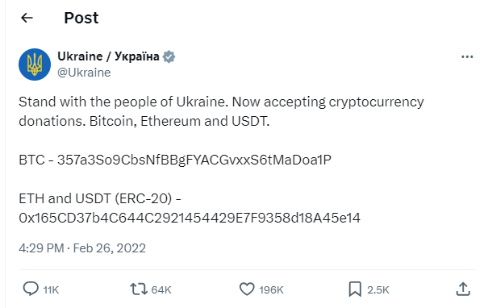
…with fast transactions…
Is 10 minuten snel?
https://bitinfocharts.com/
Notes:
Coffe cafe
Kids Wish Network, a charity for dying children, has raised $125 million for the “cause.” Of that, $110 million went directly to solicitors and $4 million into the charity founder’s pockets.
https://bitinfocharts.com/comparison/confirmationtime-btc-ltc-eth.html#1y

Slide 43
De blockchain volgen in real-time
Kijk zelf eens: www.blockchain.info
Veel werkvormen mogelijk !

Slide 44
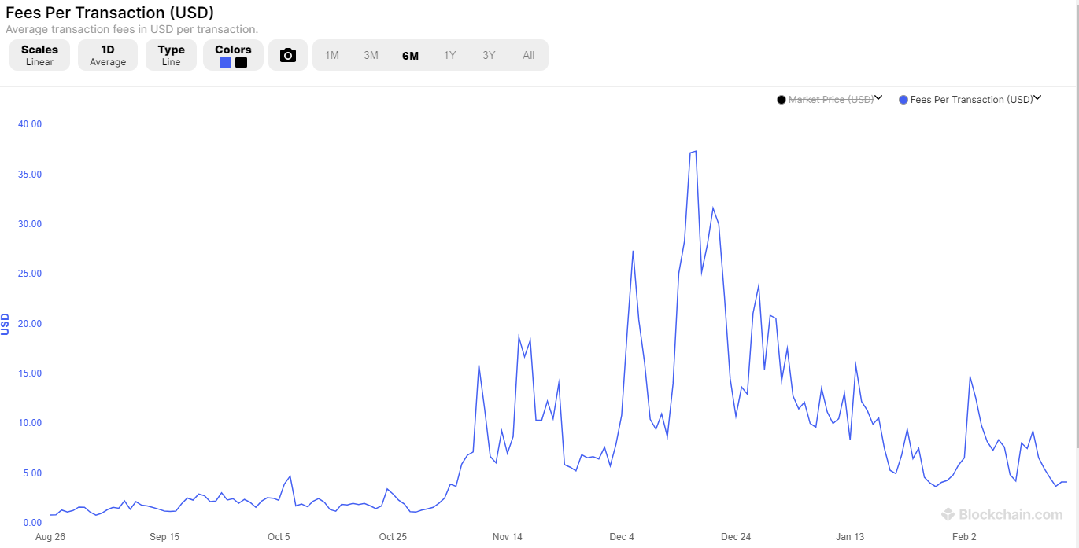
…and low fees.
Notes:
Low or not?
Unbanked people

Slide 45
Bitcoin, a peer-to-peer decentralized currency with fast transactions and low fees.
Promise

Slide 46


Slide 47
Notes:
Crypto:
- Wie kent de technologie van cryptocurrencies?
- Wie weet hoe een blockchain werkt?
- Wie bezit cryptocurrencies?

Slide 48
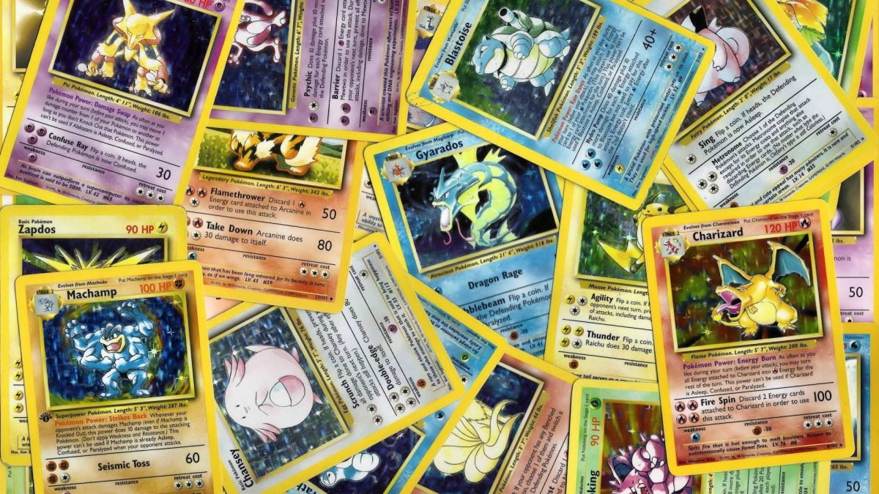
Notes:
Pokemon:
- Wie weet welke pokemonkaart het meeste waard is?
- Wie heeft er pokemonkaarten?

Slide 49
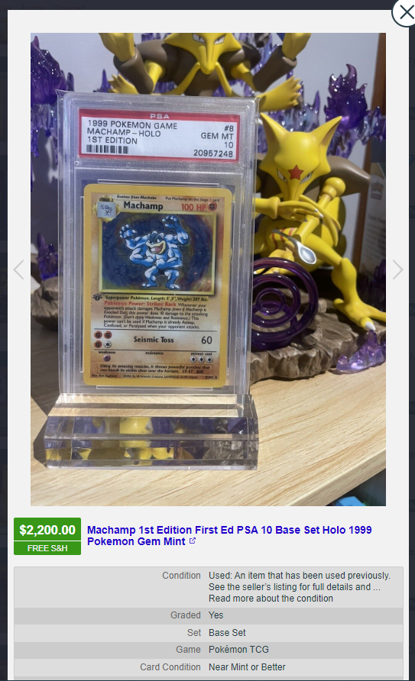
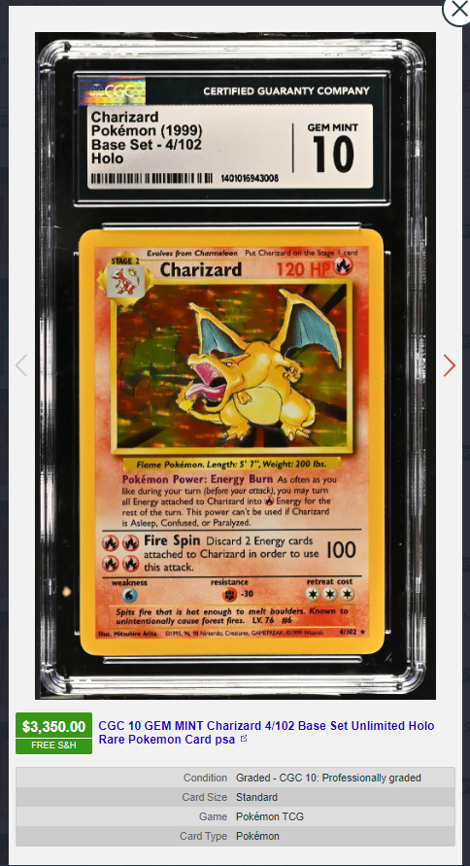

Slide 50
Investeren en beleggen in crypto
Koersen checken: www.coinmarketcap.com
Hoe risicovol is beleggen in crypto?
Waar bestaat dat risico uit?
  Volatiliteit
  Third-party risk
  Incompetence risk

Slide 51
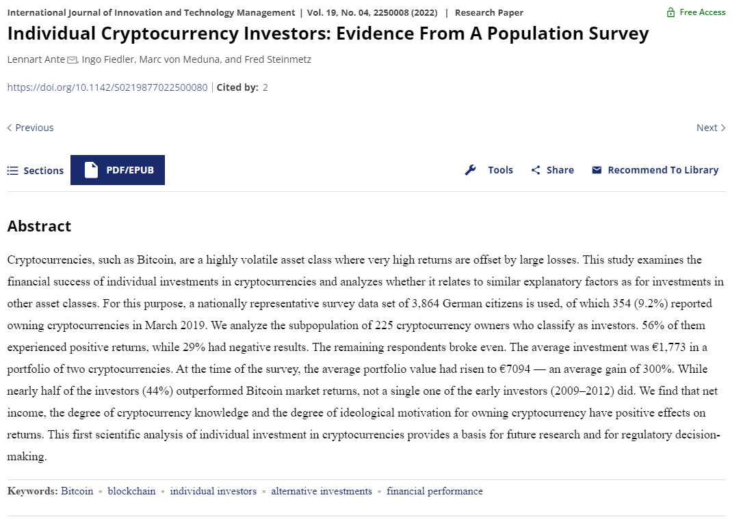

Slide 52
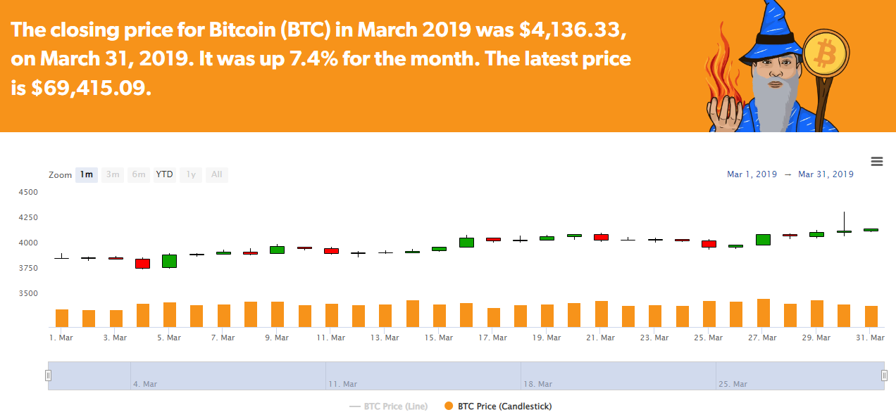

Slide 53
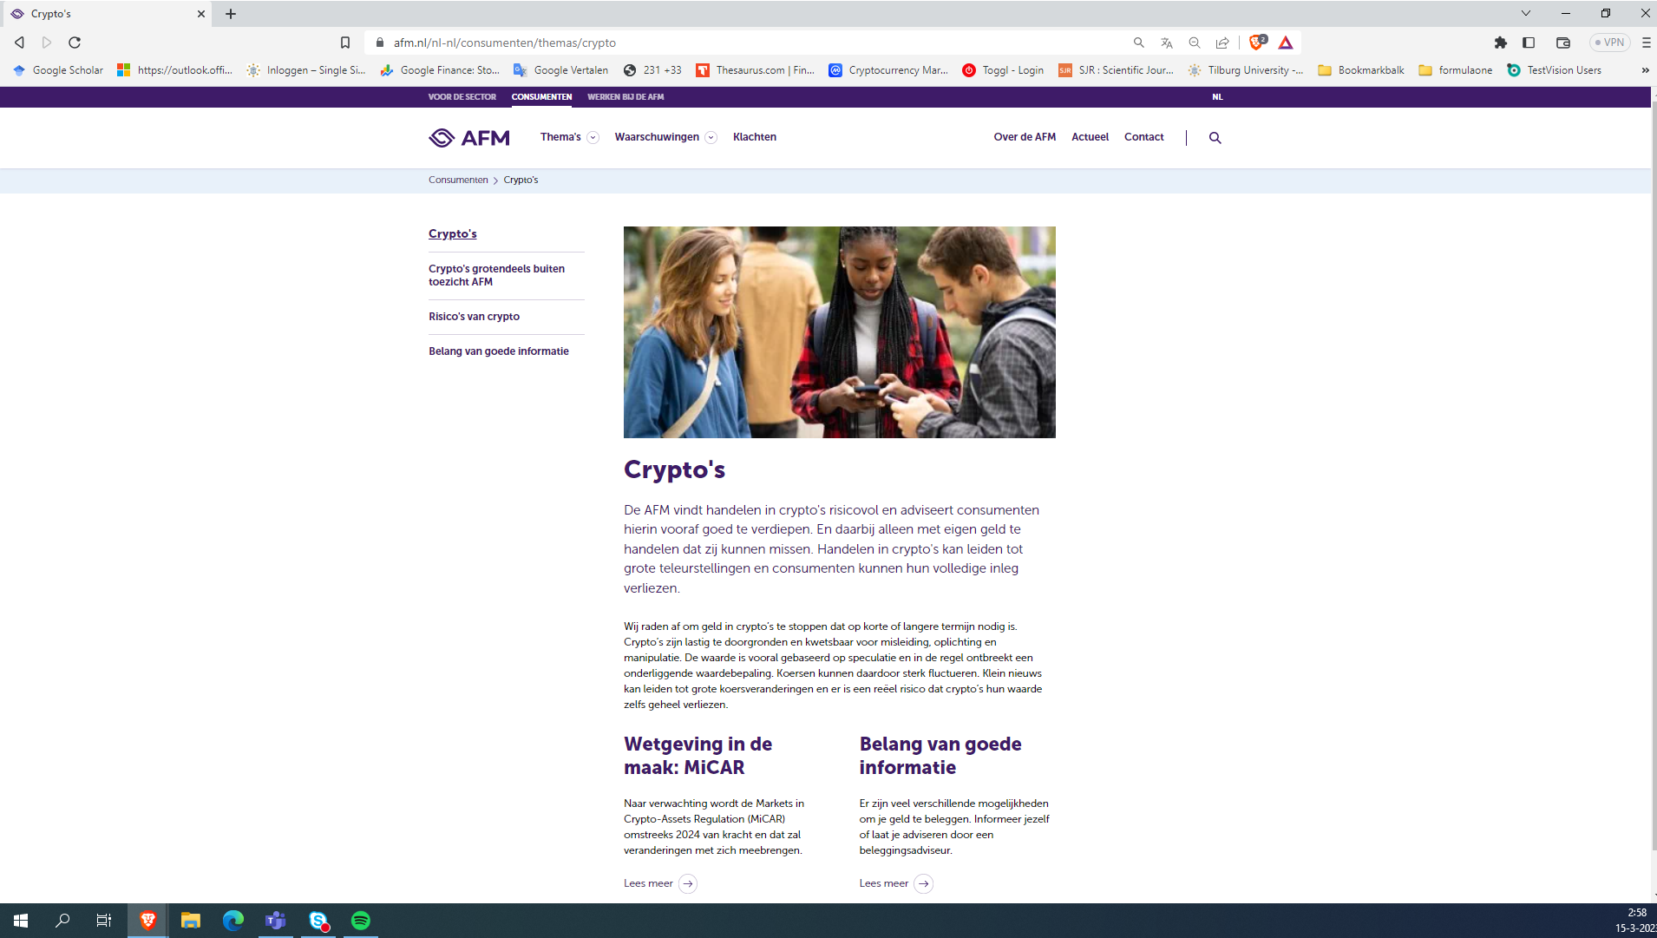
Notes:
https://www.afm.nl/nl-nl/consumenten/themas/crypto

Slide 54
Fungibility en NFT’s
Fungibility is the ability of a good or asset to be interchanged with other individual goods or assets of the same type.
Fungible assets simplify the exchange and trade processes, as fungibility implies equal value between the assets.
Is bitcoin fungible?

Slide 55

Fungibility en NFT’s

Slide 56
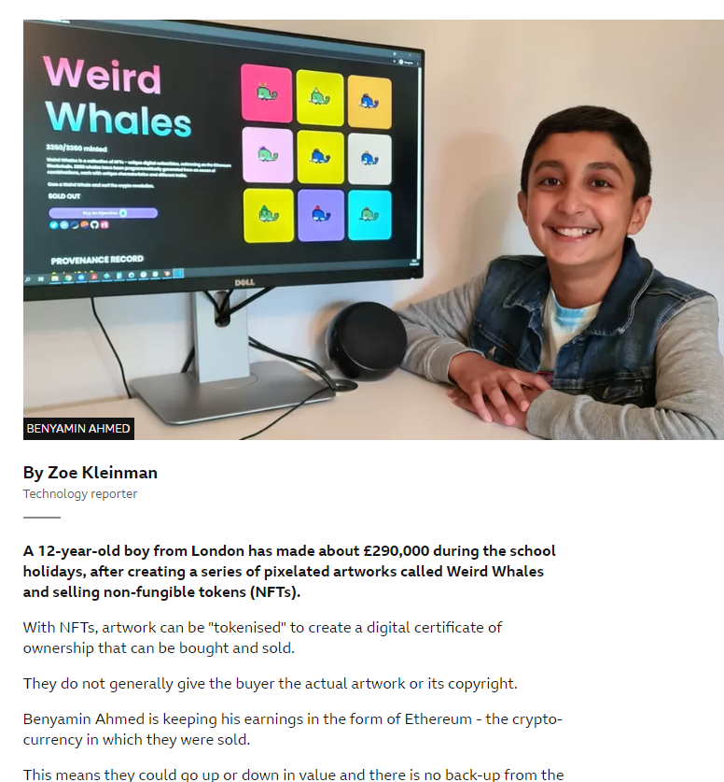

Slide 58
Wat moeten leerlingen weten?

Slide 59
Wat moeten leerlingen weten?
Wat is een cryptomunt eigenlijk?
Hoe werkt het?
Waarom is beleggen erin risicovol
Voor wie is die beleggingscategorie geschikt?
…
Notes:
Discrepantie betekent rol voor de docent

Slide 60
Bedankt
Let’s connect!

Slide 61
Bronnen
Bitcoin.org/bitcoin.pdf
“Blockchain: gedeelde grootboeken als boekhoudsysteem”, TEO 2022 nr 3.
Academisch artikel: David Yermack “Corporate governance and blockchains”
Youtube: Andreas Antonopoulos
Koersen: coinmarketcap.com
Live blockchain informatie: https://www.blockchain.com/explorer
Nieuws: Coindesk, cointelegraph
Boek: The Genesis Book, the story of the people and the projects that inspired bitcoin

